Slide 1

111th World Day of Migrants and Refugees 2025
Migrants, Missionaries of Hope
Notes:
Leader: Today we come together for the World Day of Migrants and Refugees. This year, the
celebration is part of our Jubilee year of Hope. It is not only about hope for a better future for people who set off to live in a new country, but the hope that they share with their new community. As Pope Leo says, “Many migrants, refugees and displaced persons are privileged witnesses of hope.” They inspire hope in all of us!
Image: Pexels.com

Slide 2
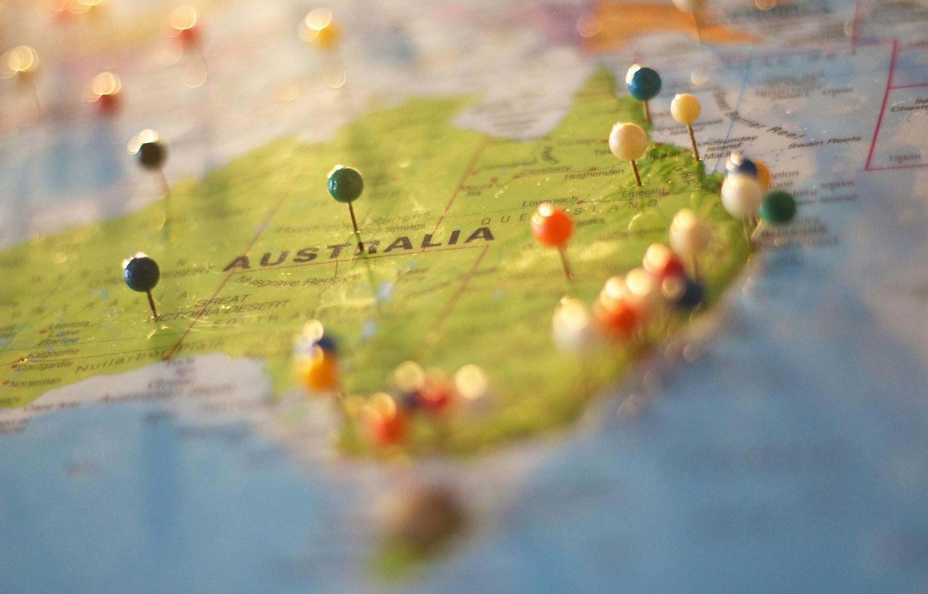
Acknowledgement
of Country and stories
Notes:
Reader 1: Let us think back to our own ancestors and the journeys that they made in hope.
Australia was settled about 65,000 years ago, and the First Nations that came here found the land good for producing food and shelter. Later, some of our great-great grandparents came here on ships, finding a new life and way to start again. Perhaps your family members have come to this land more recently, looking for safety and opportunities that weren’t possible in their home countries. Let us spend some time thinking of the migrant journeys of our own families.
[...Pause for 1 minute…]
Leader: In a moment, please turn to the person next to you and share something about your
family’s story of migration. We will have 3 minutes before we play our opening song.

Slide 3
Opening Hymn
Notes:
Music choices:
Eagles Still Soar by Trisha Watts (AOV NextGen) https://www.youtube.com/watch?v=ybSRQhUf7KI&ab_channel=WillowPublishingMusic
We Are Travellers by Trisha Watts and Monica O’Brien (AOV NextGen) We Are Travellers - YouTube
All the Ends of the Earth by Bobby Fisher (AOV NextGen) Ps. 98 All The Ends of the Earth, Bobby Fisher

Slide 4
Sign of the Cross and
Opening Prayer
Response:
Amen.
Notes:
Leader: Let us begin:
+ In the name of the Father, and of the Son, and of the Holy Spirit.
All: Amen.
Leader: Let us pray … (pause) …
God of the journey,
You send us with love and inspire us with hope.
Help us to be witnesses of faith as guests and hosts.
Through Christ our Lord,
All: Amen.

Slide 5
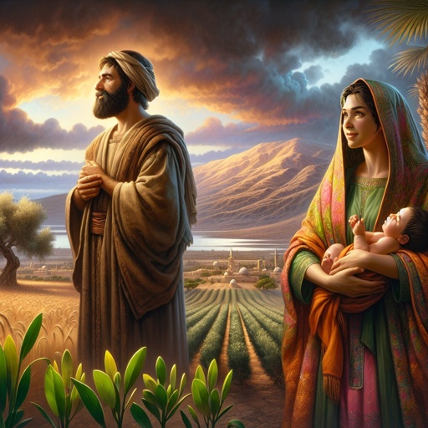
Reading: Ruth 2:10-12
Notes:
Leader: Now we will hear a passage from the bible about a journey of hope. A long time
ago, there was a Moabite woman called Ruth. Her husband was Jewish, from the town of Bethlehem. When he died, Ruth migrated with her mother-in-law to Bethlehem although she didn’t know anyone there. A man named Boaz noticed her faithfulness to her mother-in-law and to the God of the Jewish people.
Reader 2: A reading from the Book of Ruth [2:10-12, CEV].
Then Ruth said, “You know I come from another country. Why are you so good to
me?” Boaz answered, “I've heard how you've helped your mother-in-law ever since your husband died. You even left your own father and mother to come and live in a foreign land among people you don't know. I pray that the Lord God of Israel will reward you for what you have done. And now that you have come to him for protection, I pray that he will bless you.”
… (pause) …
Leader: Boaz was so impressed by Ruth that it gave him hope in his own life. They got
married and became the great-grandparents of King David. Many years later, Jesus was also born far from his parent’s home, in Bethlehem, the town of hope.
Image: bible.art

Slide 6
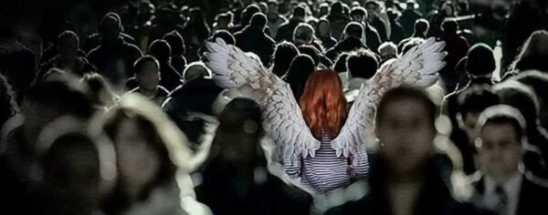
Reading: Hebrews 13:1-2,5b-6
Notes:
We will now hear a message in the New Testament from the Letter to the Hebrews. It reminds us of the blessing of strangers in our lives.
Reader 3: A reading from the Letter to the Hebrews [13:1-2,5b-6, NRSV]
Let mutual love continue. Do not neglect to show hospitality to strangers, for by doing that some have entertained angels without knowing it. God has said, ‘I will never leave you or forsake you.’ So we can say with confidence, ‘The Lord is my helper; I will not be afraid. What can anyone do to me?’
… (pause) …
Image: goodnewstext.org

Slide 7
Responding in Prayer
God of hope, hear us…
Response:
God of hope,
hear our prayer.
Notes:
Leader: As both guests and hosts in this land, we turn to our God who attends to all our
needs. Our response to each prayer is ‘God of hope, hear our prayer’.
Reader 4: We pray for people who travel across borders in the hope of a better life.
May their trust in God lead them to the safety of a new home.
God of hope, hear us.
All: God of hope, hear our prayer.
Reader 5: We pray for those who face trauma and separation along the way.
May they keep faith and hope alive even in the difficult times. God of hope, hear us.
All: God of hope, hear our prayer.
Reader 6: We pray for communities that host migrants and refugees.
May their courage and strength be a witness to hope for all. God of hope, hear us.
All: God of hope, hear our prayer.
Reader 7: We pray for our local churches.
May their faith come to life as places of welcome and inter-religious dialogue. God of hope, hear us.
All: God of hope, hear our prayer.

Slide 8
Hail, Mary, full of grace,
the Lord is with thee.
Blessed art thou among women
and blessed is the fruit of thy womb, Jesus.
Holy Mary, Mother of God,
pray for us sinners,
now and at the hour of our death.
Amen.
Notes:
Leader: And with Pope Leo, we “entrust all those who are on the journey, as well as those
who are working to accompany them, to the maternal protection of the Virgin Mary, comfort of migrants, so that she may keep hope alive in their hearts and sustain them in their commitment to building a world that increasingly resembles the Kingdom of God, the true homeland that awaits us at the end of our journey.”
All: Hail Mary…

Slide 9
Lord, make me an instrument of your peace:
where there is hatred, let me sow love;
where there is injury, pardon;
where there is doubt, faith;
where there is despair, hope;
where there is darkness, light;
where there is sadness, joy.
Notes:
Leader: So let us conclude with the prayer of Saint Francis of Assisi:
All: Lord, make me an instrument of your peace:
where there is hatred, let me sow love;
where there is injury, pardon;
where there is doubt, faith;
where there is despair, hope;
where there is darkness, light;
where there is sadness, joy.

Slide 10
O divine Master, grant that I may not so much seek
to be consoled as to console,
to be understood as to understand,
to be loved as to love.
For it is in giving that we receive,
it is in pardoning that we are pardoned,
and it is in dying that we are born to eternal life. Amen.
Notes:
O divine Master, grant that I may not so much seek
to be consoled as to console,
to be understood as to understand,
to be loved as to love.
For it is in giving that we receive,
it is in pardoning that we are pardoned,
and it is in dying that we are born to eternal life.
Amen.

Slide 11
Blessing and Sign of the Cross
Response: Amen.
Response:
Thanks be to God!
Notes:
Leader: May God, the creator of all lands, bless us.
All: Amen.
Leader: May Jesus, traveller and friend on the journey, bless us.
All: Amen.
Leader: May the Holy Spirit, who inspires us with hope, bless us.
All: Amen.
Leader: And let us go in peace, as missionaries of hope.
All: Thanks be to God!

Slide 12
111th World Day of Migrants and Refugees 2025
Migrants, Missionaries of Hope

