Slide 1
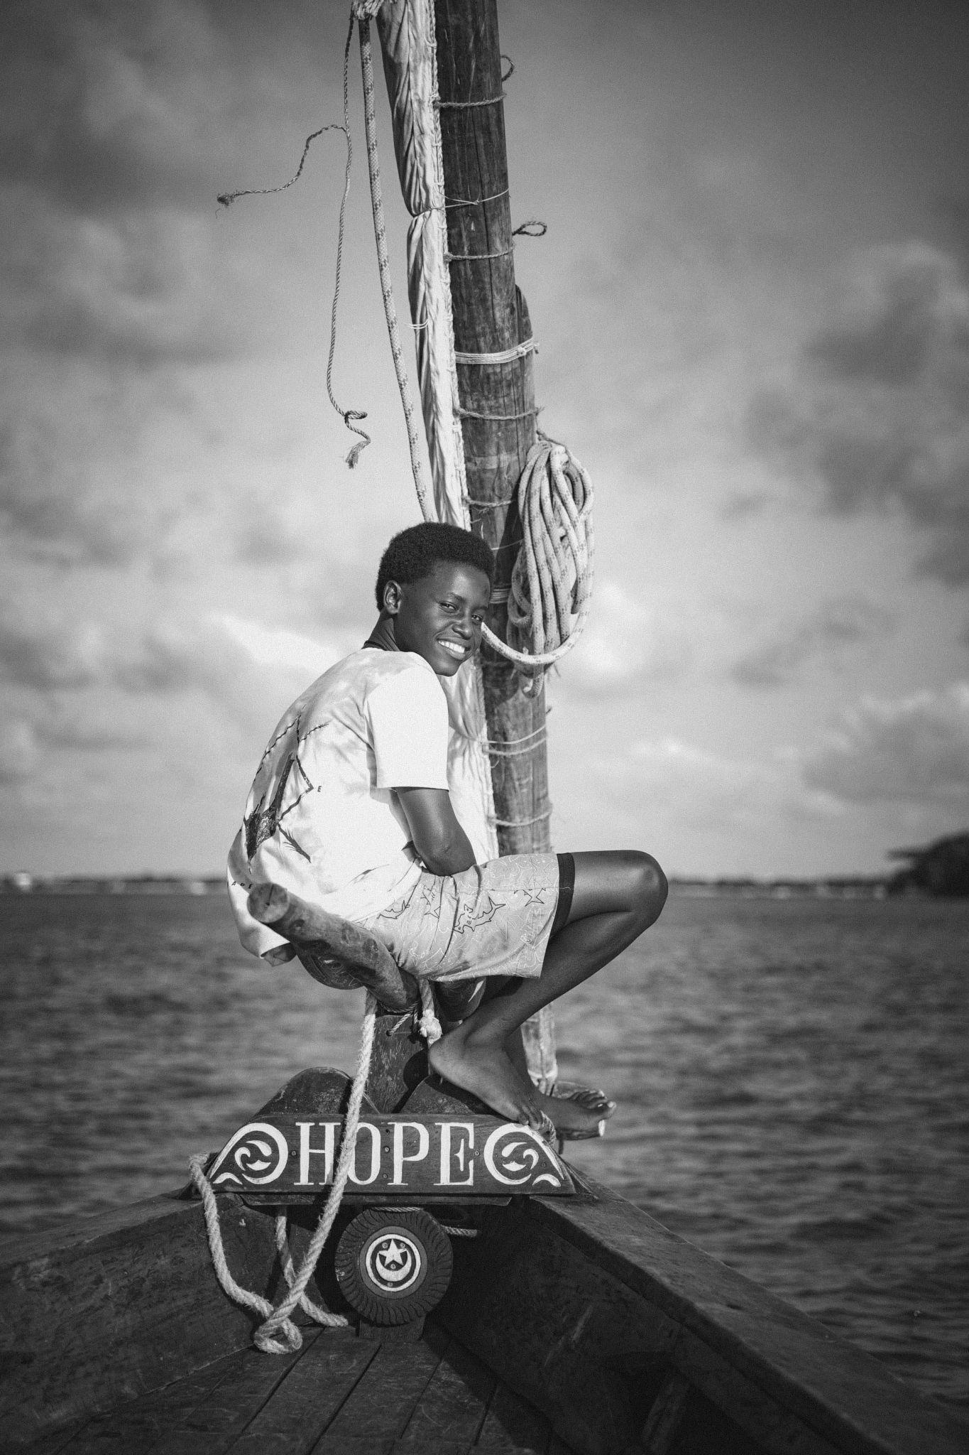
111th World Day of Migrants and Refugees 2025
Migrants, Missionaries of Hope
Notes:
Leader: Today we come together for the World Day of Migrants and Refugees. This year, the
celebration is part of our Jubilee year of Hope. Let us begin by closing our eyes…
Reader 1: Imagine you are living in a country far away from here…
Things are pretty difficult and there is not enough food to eat and no safe place to sleep at night…
Imagine what you would hope for…
Maybe you hope for a country where there is good food, good water and a warm bed…
But to get there you need to leave home and to trust in God…
Imagine you travel across seas and borders to get to your new land…
People welcome you and say it is good that you are here…
Your courage and faith have given them hope…
Imagine celebrating together.
Leader: Let us open our eyes. Whether it was your family, your great-grandparents or your
long-ago ancestors, all of us have travelled here as migrants. Aboriginal and Torres Strait Islander people came about 65,000 years ago. Others came on ships and some by plane. Everyone came to Australia with hope in God for a good life. And we celebrate their courage, faith and strength. They have been missionaries of hope for us. They remind us that God will never let us down. We should always have hope!
Image: Pexels.com

Slide 2
Sign of the Cross and
Opening Prayer
Response:
Amen.
Notes:
Leader: Let us begin:
+ In the name of the Father, and of the Son, and of the Holy Spirit.
All: Amen.
Leader: Let us pray … (pause) …
God of hope,
You send us out with courage and love.
Help us to be missionaries of hope in our world.
Through Christ our Lord,
All: Amen.

Slide 3
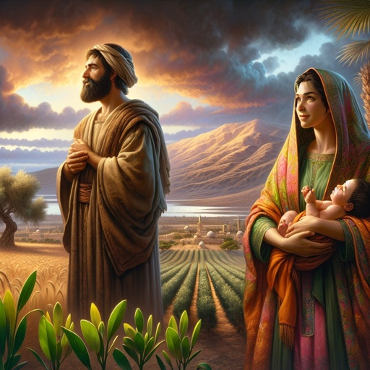
Reading: Ruth 2:10-12
Notes:
Leader: Now we will hear a passage from the bible about a journey of hope. A long time
ago, there was a Moabite woman called Ruth. Her husband was Jewish, from the town of Bethlehem. When he died, Ruth migrated with her mother-in-law to Bethlehem although she didn’t know anyone there. A man named Boaz noticed her care for her mother-in-law and faith in the God of the Jewish people.
Reader 2: A reading from the Book of Ruth [2:10-12, CEV].
Then Ruth said, “You know I come from another country. Why are you so good to
me?” Boaz answered, “I've heard how you've helped your mother-in-law ever since your husband died. You even left your own father and mother to come and live in a foreign land among people you don't know. I pray that the Lord God of Israel will reward you for what you have done. And now that you have come to him for protection, I pray that he will bless you.”
… (pause) …
Leader: Boaz was so happy with Ruth that it gave him hope in his own life. They got
married and became the great-grandparents of King David. Many years later, Jesus was also born far away from his parent’s home, in Bethlehem, the town of hope.
Image: bible.art

Slide 4
Responding in Prayer
God of hope,
hear us…
Response:
God of hope,
hear our prayer.
Notes:
Leader: Let us now offer our prayers. Sometimes we are strangers and sometimes we
welcome the strangers. We keep turning to God in hope. Our response to each prayer is ‘God of hope, hear our prayer’.
Reader 3: We pray for people who go to different countries in the hope of a better life.
May they trust in God and find a safe home.
God of hope, hear us.
All: God of hope, hear our prayer.
Reader 4: We pray for those who have a really difficult time along the way.
May they keep faith and hope alive.God of hope, hear us.
All: God of hope, hear our prayer.
Reader 5: We pray for people who care for migrants and refugees.
May their courage and strength give them hope. God of hope, hear us.
All: God of hope, hear our prayer.
Reader 6: We pray for our local churches.
May their faith lead to welcome and learning from each other. God of hope, hear us.
All: God of hope, hear our prayer.

Slide 5
Hail, Mary, full of grace,
the Lord is with thee.
Blessed art thou among women
and blessed is the fruit of thy womb, Jesus.
Holy Mary, Mother of God,
pray for us sinners,
now and at the hour of our death.
Amen.
Notes:
Leader: And with Pope Leo, we place all those who are on the journey in the motherly care
of the Virgin Mary, comfort of migrants.
All: Hail Mary…

Slide 6
Lord, make me an instrument of your peace:
where there is hatred, let me sow love;
where there is injury, pardon;
where there is doubt, faith;
where there is despair, hope;
where there is darkness, light;
where there is sadness, joy. Amen.
Notes:
Leader: So let us conclude with the prayer of Saint Francis of Assisi:
All: Lord, make me an instrument of your peace:
where there is hatred, let me sow love;
where there is injury, pardon;
where there is doubt, faith;
where there is despair, hope;
where there is darkness, light;
and where there is sadness, joy.
Amen.

Slide 7
Blessing and Sign of the Cross
Response: Amen.
Response:
Thanks be to God!
Notes:
Leader: May God, the creator of all lands, bless us.
All: Amen.
Leader: May Jesus, traveller and friend on the journey, bless us.
All: Amen.
Leader: May the Holy Spirit, who inspires us with hope, bless us.
All: Amen.
Leader: And let us go in peace, as missionaries of hope.
All: Thanks be to God!

Slide 8
Closing
hymn
Notes:
Music choices:
Land of the Southern Cross by Michael Mangan (True Colours Shine) www.youtube.com/watch?v=Ht7pubAsLmc&ab_channel=MichaelMangan-Topic
Hope is Alive! by Gen Bryant and Ashen Warnakulasooriya (Willow) https://www.youtube.com/watch?v=_P6uYpni-Yk&ab_channel=GenBryant

Slide 9
111th World Day of Migrants and Refugees 2025
Migrants, Missionaries of Hope

