Slide 1
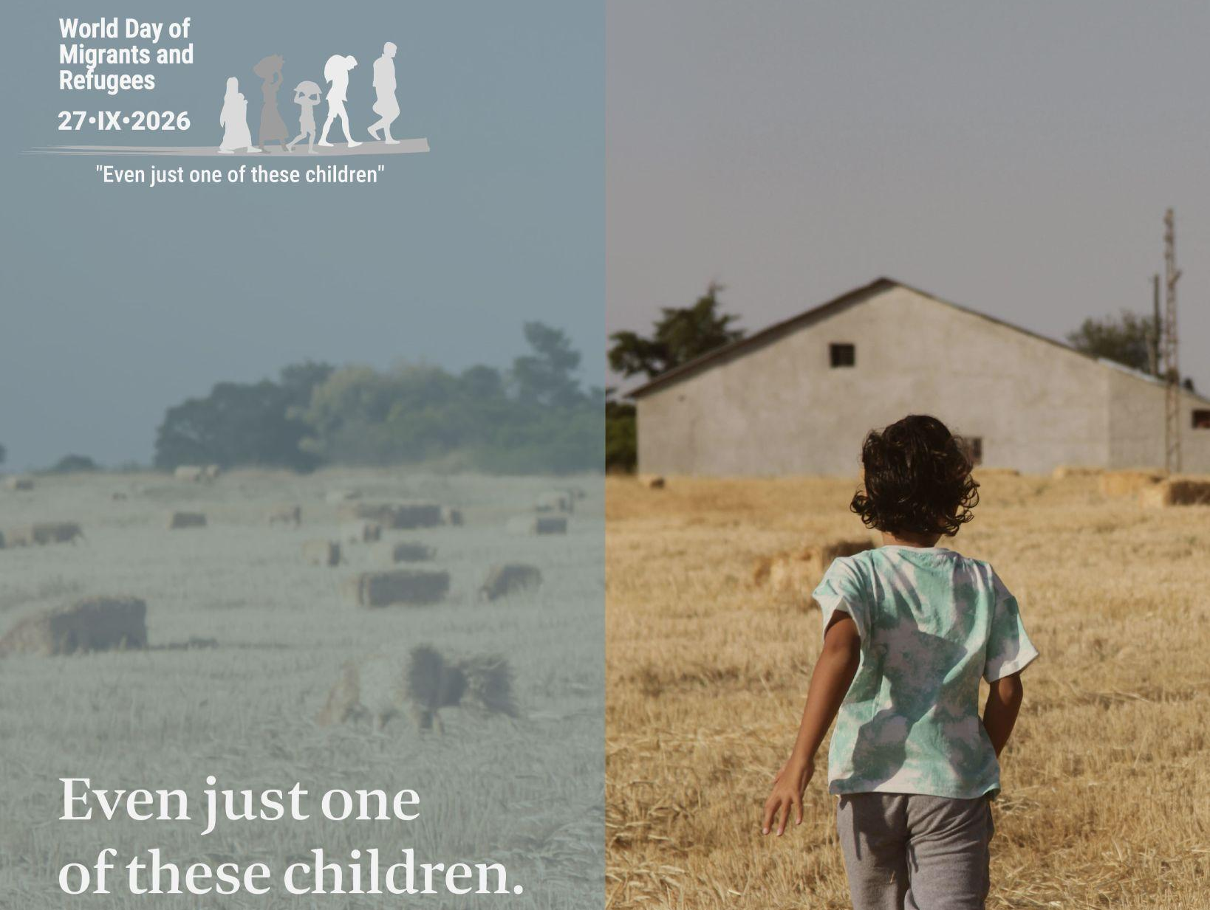
Notes:
Leader: Today we celebrate the World Day of Migrants and Refugees. Pope Leo has asked
for our thoughts and prayers for child migrants, and his theme for the day is ‘Even Just One of These Children’.
Image: Dicastery of Human Development

Slide 2
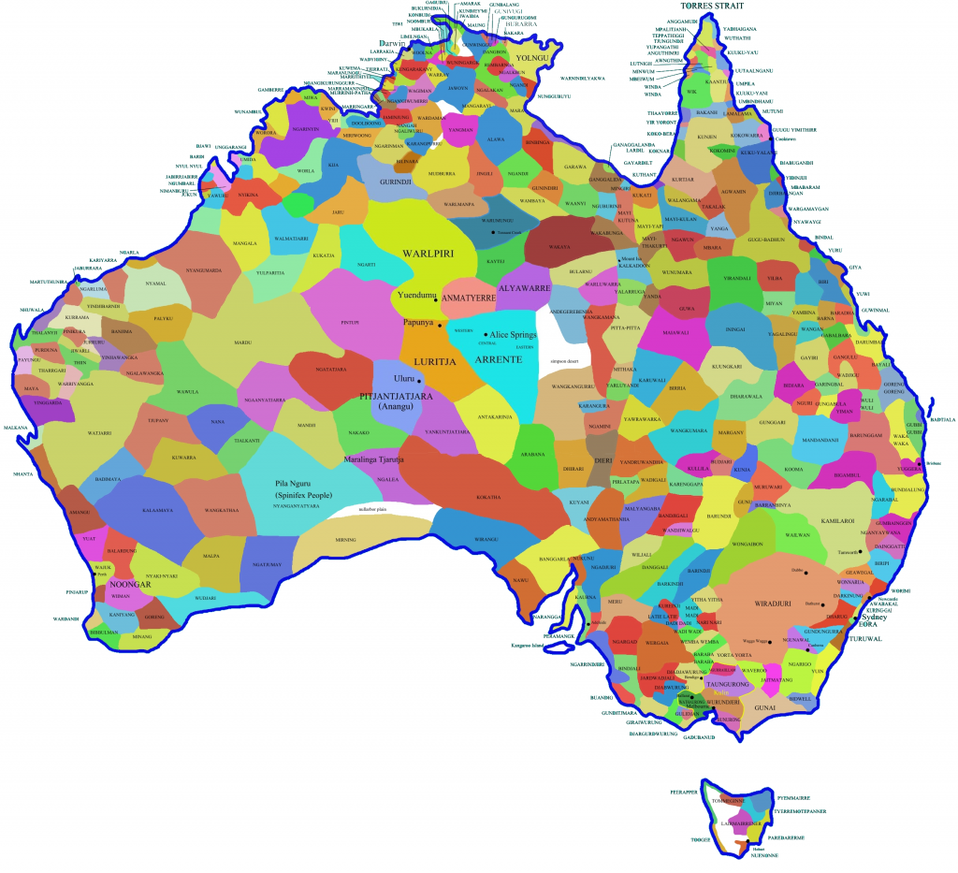
Acknowledgement
of Country
Notes:
Reader 1: Let us first acknowledge the indigenous custodians of this place, the … people. We recognise their Elders, past and present. Today, we especially acknowledge the emerging Elders who face the challenges of young people here and around the world. May we grow together as a community of hope.
[...Pause for 30 seconds…]
Leader: Now for the next reflection, please close your eyes. We will wait for everyone to have their eyes closed to begin.
Reader 2: [Pause between each sentence.] Think back to your childhood…
What are some of your memories?
Did you have a favourite toy?
Did you have a favourite game?
What were some of the fun things you did back then?
What were some of the difficult things about being a child?
What do you hope for a child growing up today?

Slide 3
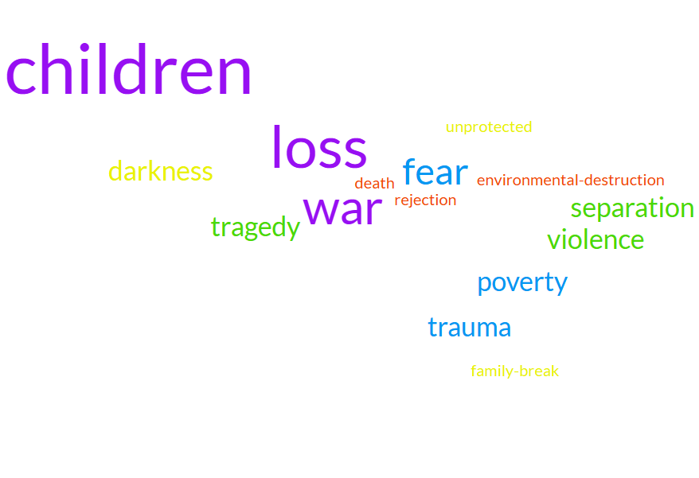
Child migrant experiences
Notes:
Now open your eyes.
On the screen are some of the childhood experiences that Pope Leo talks about in his message for the World Day of Migrants and Refugees. He says that child migrants are defenceless because they are children, foreigners and have no way to protect themselves. So our call today is to do our part to welcome and protect children who suffer on their journeys. Alongside practical help, we can always remember and pray for them.

Slide 4
Sign of the Cross and
Opening Prayer
Response:
Amen.
Notes:
Leader: Let us begin:
+ In the name of the Father, and of the Son, and of the Holy Spirit.
All: Amen.
Opening Prayer
Leader: Let us pray … (pause) …
Loving God,
You send your angels to care for every child.
Build with us a world where each one is safe and protected.
Through Christ our Lord,
All: Amen.

Slide 5
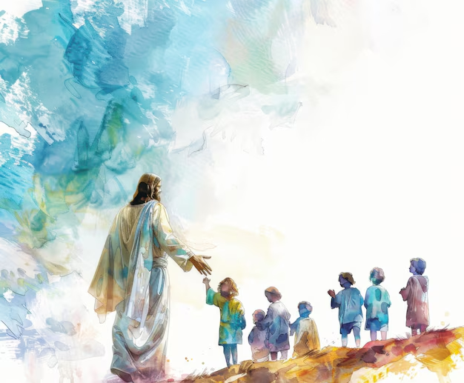
Reading: Matthew 18:2,5,10; 19:13-14
Notes:
Reader 3: A reading from the Gospel of Matthew [18:2,5,10; 19:13-14, NRSV].
Jesus called a little child to him, and placed the child among them. And he said:
“Whoever welcomes one such child in my name welcomes me. See that you do not despise one of these little ones. For I tell you that their angels in heaven always see the face of my Father in heaven.” Then people brought little children to Jesus for him to place his hands on them and pray for them. But the disciples rebuked them. Jesus said, “Let the little children come to me, and do not hinder them, for the kingdom of heaven belongs to such as these.”
… (pause) …
Image: freepix.com

Slide 6
Responding in Prayer
Lord, hear us.
Response:
Lord, hear our prayer.
Notes:
Leader: Now let us turn to our God with the trust of these children, knowing God’s desire to
hear and answer our needs.
Reader 4: For children forced to leave their homes because of war, poverty, violence,
environmental disasters and other tragedies.
May their angels watch over their travels and may they find safety and peace. Lord, hear us.
All: Lord, hear our prayer.
Reader 5: For child migrants separated from their parents and families.
May they receive the love and comfort they need. Lord, hear us.
All: Lord, hear our prayer.
Reader 6: For children who are exploited or abused in their travel or foreign lands.
May governments and aid agencies do all they can to protect their best interests. Lord, hear us.
All: Lord, hear our prayer.
Reader 7: For those who care for migrants and their children.
May the whole Christian community see each other as God’s precious sons and
daughters. Lord, hear us.
All: Lord, hear our prayer.
Reader 8: For families who experience death, and for children who know the trauma of grief
and loss.
May they trust in God’s loving welcome in heaven. Lord, hear us.
All: Lord, hear our prayer.
Leader: Eternal God, you have shown us the way of love and mercy in your son Jesus. Help
us to reach out to even just one of these children with welcome and joy. Through Christ our Lord.
All: Amen.

Slide 7
Our Father, Who art in heaven,
Hallowed be Thy Name.
Thy Kingdom come.
Thy Will be done,
on earth as it is in Heaven.
Give us this day our daily bread.
And forgive us our trespasses,
as we forgive those who trespass against us.
And lead us not into temptation,
but deliver us from evil. Amen.

Slide 8
Hail, Mary, full of grace,
the Lord is with thee.
Blessed art thou among women
and blessed is the fruit of thy womb, Jesus.
Holy Mary, Mother of God,
pray for us sinners,
now and at the hour of our death.
Amen.
Notes:
Leader: Pope Leo concludes his letter: “Let us entrust migrant and refugee children to the maternal protection of the Blessed Virgin Mary who, together with Saint Joseph and the child Jesus experienced the cruelty of Herod’s violence and the tragedy of exile in Egypt. May she accompany their steps and help our communities to become living and credible signs of the Gospel.” So let us conclude by praying together:
All: Hail Mary...

Slide 9
Blessing and Sign of the Cross
Response: Amen.
Response:
Thanks be to God!
Notes:
Leader: May the hands of the creator God bless us.
All: Amen.
Leader: May the hands of the welcoming Jesus bless us.
All: Amen.
Leader: May the Holy Spirit and the angels of God guide and bless our ways.
All: Amen.
Leader: And let us go in peace to love and serve the Lord.
All: Thanks be to God!

Slide 10
