Slide 1
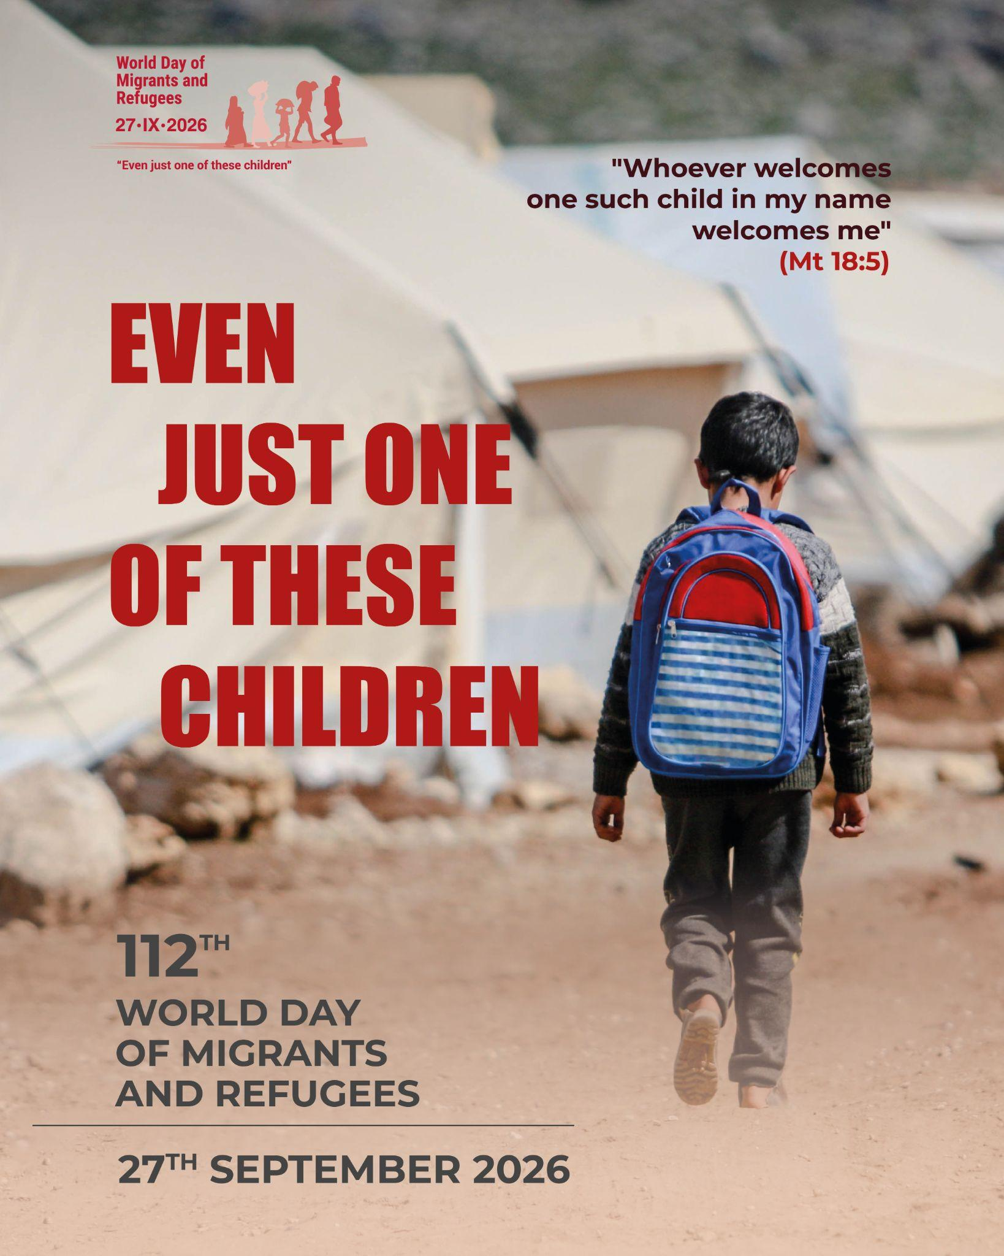
Notes:
Leader: Today we celebrate the World Day of Migrants and Refugees. Pope Leo has asked for our thoughts and prayers for child migrants, and his theme for the day is ‘Even Just One of These Children’.
Image: Dicastery of Human Development

Slide 2
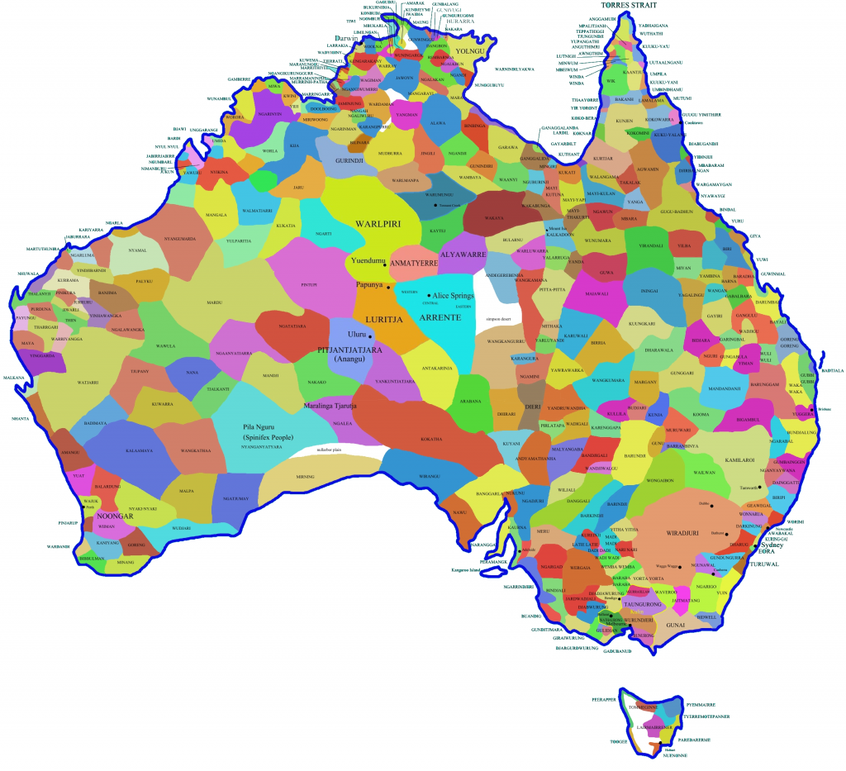
Acknowledgement
of Country
Notes:
Reader 1: Let us first remember those who cared for this place for many, many years, the … [local indigenous] … people. We remember their Elders, past and present. Today, we think about the children who will become Elders one day. May we grow together as a people of hope.
[...Pause for 30 seconds…]

Slide 3
Notes:
Leader: We all have a different experience of being a child. Life was very different when I was a child! What are some of the fun things about being a child today? [Wait for some responses.] Are there any difficult things about being a child? [Wait for some responses.]
Yes, life can be very fun as a child and also very difficult. Some children have very hard lives as they have to leave their homes to go somewhere else. Sometimes it is not safe in their country and they have to go to a new place where they don’t have a home and can’t speak the language. Some have to say goodbye to family members forever, and it can be very scary. What do you hope for children around the world? [Wait for some responses.]
Well, today Pope Leo asks us to remember the children who have to leave home and to pray for them. We also remember each one of us, and know that God thinks we are special children, who have an important place in the world.

Slide 4
Sign of the Cross and
Opening Prayer
Response:
Amen.
Notes:
Leader: Let us begin:
+ In the name of the Father, and of the Son, and of the Holy Spirit.
All: Amen.
Opening Prayer
Leader: Let us pray … (pause) …
Loving God,
You send your angels to care for every child.
Build with us a world where each one is safe and protected.
Through Christ our Lord,
All: Amen.

Slide 5
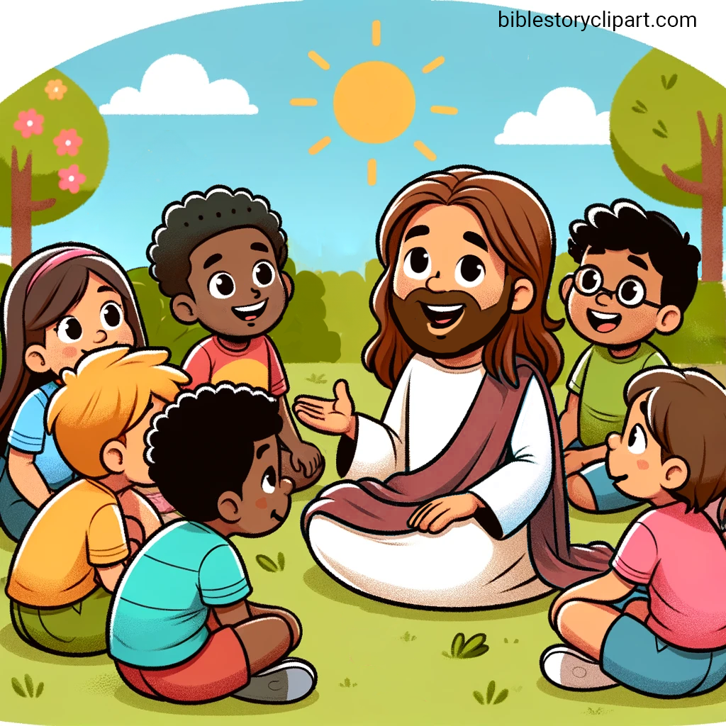
Reading: Matthew 18:2,5,10; 19:13-14
Notes:
Reader 2: A reading from the Gospel of Matthew [18:2,5,10; 19:13-14, NRSV].
Jesus called a little child to him, and placed the child among them. And he said:
“Whoever welcomes one such child in my name welcomes me. See that you do not despise one of these little ones. For I tell you that their angels in heaven always see the face of my Father in heaven.” Then people brought little children to Jesus for him to place his hands on them and pray for them. But the disciples rebuked them. Jesus said, “Let the little children come to me, and do not hinder them, for the kingdom of heaven belongs to such as these.”
… (pause) …
Image: biblestoryclipart.com

Slide 6
Responding in Prayer
Lord, hear us…
Response:
Lord, hear our prayer.
Notes:
Leader: Now let us turn to our God with the trust of these children, knowing that God wants
to hear and answer our needs.
Reader 3: For children who have to leave their homes because of war, poverty or
environmental disasters.
May their angels watch over them and help them find safety and peace. Lord, hear us.
All: Lord, hear our prayer.
Reader 4: For child migrants who lose their parents and families.
May they receive the love and comfort they need. Lord, hear us.
All: Lord, hear our prayer.
Reader 5: For children who are treated badly in their travels or new country.
May good adults do all they can to protect their best interests. Lord, hear us.
All: Lord, hear our prayer.
Reader 6: For those who care for migrants and their children.
May all Christians see each other as God’s precious sons and daughters. Lord, hear
us.
All: Lord, hear our prayer.
Reader 7: For families who know the grief of losing loved ones.
May they trust in God’s loving welcome in heaven. Lord, hear us.
All: Lord, hear our prayer.
Leader: Faithful God, you have shown us the way of love in your son Jesus. Help us to
reach out to even just one of these children with welcome and joy. Through Christ our Lord.
All: Amen.

Slide 7
Our Father, Who art in heaven,
Hallowed be Thy Name.
Thy Kingdom come.
Thy Will be done,
on earth as it is in Heaven.
Give us this day our daily bread.
And forgive us our trespasses,
as we forgive those who trespass against us.
And lead us not into temptation,
but deliver us from evil. Amen.

Slide 8
Hail, Mary, full of grace,
the Lord is with thee.
Blessed art thou among women
and blessed is the fruit of thy womb, Jesus.
Holy Mary, Mother of God,
pray for us sinners,
now and at the hour of our death.
Amen.
Notes:
Leader: Pope Leo ends his letter: “Let us entrust migrant and refugee children to the motherly protection of the Blessed Virgin Mary. May she accompany their steps and help us to become people of the Good News.” So let us conclude by praying together:
All: Hail Mary...

Slide 9
Blessing and Sign of the Cross
Response: Amen.
Response:
Thanks be to God!
Notes:
Leader: May the hands of the creator God bless us.
All: Amen.
Leader: May the hands of the welcoming Jesus bless us.
All: Amen.
Leader: May the Holy Spirit and the angels of God guide and bless our ways.
All: Amen.
Leader: And let us go in peace to love and serve the Lord.
All: Thanks be to God!

Slide 10


