Slide 1

110th World Day of Migrants and Refugees 2024
God walks with us
Notes:
Leader: Today we come together for the World Day of Refugees and Migrants. Let us begin
by imagining yourself on a walk. (...pause…) Where are you going? What is the
path like? What can you see around you? Who are you walking with?
We have been on many walks in our lives, or travelled by bike, car, boat or aeroplane. Those of us who are migrants or refugees have also been on long journeys across countries, borders or seas. The way has been difficult, the journey has been long.
But Pope Francis wants us to remember that God always walks with us. In the
difficulties, many migrants experience God as a traveling companion, guide or the anchor of a boat. God comforts us and gives us hope along the way. Pope Francis also says that God walks within us as we go. God identifies with all those who are lost and struggling on the road.

Slide 2
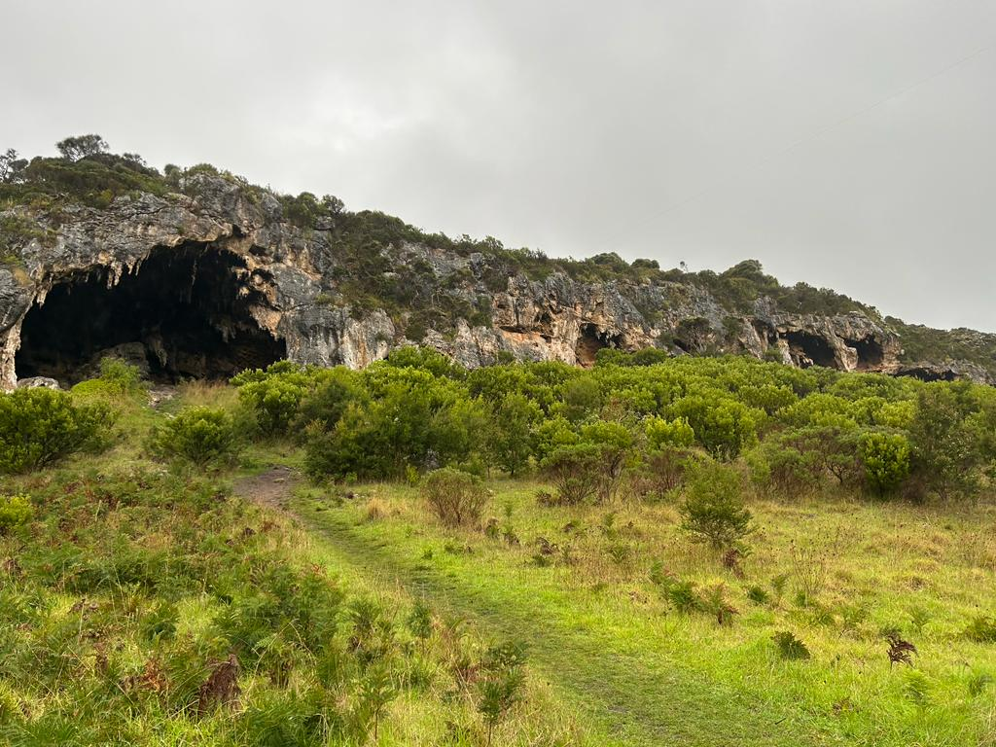
Acknowledgement
of Country
Notes:
Leader: So as we remember all those who have travelled here, let us acknowledge the First Peoples of this land.
Reader 1: We acknowledge the people who have cared for this special sacred land for thousands of generations. We thank them for walking gently on this earth and for
teaching the way of deep listening. We pray that we can show our respects by walking together on God’s way of justice, reconciliation and hope.

Slide 3
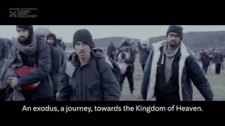
Notes:
Leader: We will now watch a video about Pope Francis’s message for the World Day of
Migrants and Refugees.

Slide 4
Sign of the Cross and
Opening Prayer
Response: Amen.
Notes:
Leader: Let us begin:
+ In the name of the Father, and of the Son, and of the Holy Spirit.
All: Amen.
Opening Prayer
Leader: Let us pray in the words of Pope Francis … (pause) …
God, Almighty Father,
we are your pilgrim Church
journeying towards the Kingdom of heaven.
We live in our homeland,
but as if we were foreigners.
Every foreign place is our home,
yet every native land is foreign to us.
Though we live on earth,
our true citizenship is in heaven.
Do not let us become possessive
of the portion of the world
you have given us as a temporary home.
Through Christ our Lord,
All: Amen.

Slide 5
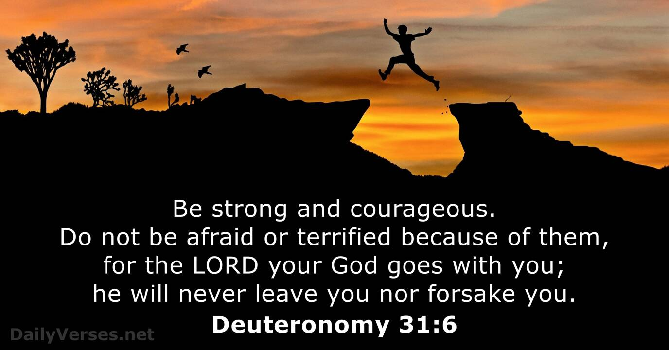
Reading: Deuteronomy 31:1-3,6,8
Notes:
Leader: Now let us listen to a passage from the bible. It is from the Old Testament, part of the story of Moses and the Israelite people. He led them from slavery in Egypt to safety in the Promised Land. But Moses was old when they arrived and ready to die. The Israelites were afraid of travelling on without him.
Scripture
Reader 2: A reading from the Book of Deuteronomy [31:1-3,6,8, NRSV].
When Moses had finished speaking all these words to all Israel, he said to them: ‘I
am now a hundred and twenty years old. I am no longer able to get about, and the Lord has told me, “You shall not cross over this Jordan.” The Lord your God himself will cross over before you… Be strong and bold; have no fear or dread of them, because it is the Lord your God who goes with you; he will not fail you or forsake you. It is the Lord who goes before you. He will be with you; he will not fail you or forsake you. Do not fear or be dismayed.’

Slide 6
Sharing my Story
Notes:
Leader: We have asked … to share a little with us on some of the challenges on their own
journey.
[Person to share.]

Slide 7

Reflect: God’s presence with migrants and refugees on their journeys
Notes:
Leader: Let us now take some time to reflect on God’s presence with migrants and refugees on their journeys

Slide 8
Responding in Prayer
In all of our trials…
Response:
God walks the journey with us.
Notes:
Leader: We heard in the scripture that the Israelite people lost their leader along the way.
They faced many challenges and difficulties, just like migrants and refugees today. Now we offer our prayers to God for everyone on journeys like these. Our response to each prayer is ‘God walks the journey with us’.
Reader 3: We pray for people who have lost their way. May they find good guides to a place of
safety. In all of our trials...
All: God walks the journey with us.
Reader 4: We pray for families and friends who are separated. May they be comforted and
keep each other in love, thought and prayer. In all of our trials...
All: God walks the journey with us.
Reader 5: We pray for people who are sick or injured along the journey. May they receive help
and encouragement to continue. In all of our trials...
All: God walks the journey with us.
Reader 6: We pray for those who are afraid of the future or exhausted from their travels. May
they have the strength and hope they need. In all of our trials...
All: God walks the journey with us.

Slide 9
Our Father who art in heaven,
hallowed be thy name.
Thy kingdom come.
Thy will be done
on earth, as it is in heaven.
Give us this day
our daily bread,
Notes:
Leader: Let us bring all our prayers to God who travels with us, in the words of Jesus:
All: Our Father...

Slide 10
and forgive us our trespasses,
as we forgive those who trespass against us,
and lead us not into temptation,
but deliver us from evil. Amen.

Slide 11
Help us to keep walking,
together with our migrant brothers and sisters,
toward the eternal dwelling you have prepared for us.
Open our eyes and our hearts
so that every encounter with those in need
becomes an encounter with Jesus, your Son and our Lord.
Amen.
Notes:
Leader: So let us conclude with the final part of the prayer of Pope Francis:

Slide 12
Blessing and Sign of the Cross
Response: Amen.
Response:
Thanks be to God!
Notes:
Blessing and Dismissal
Leader: May God bless us on the journey + Father, Son, and Holy Spirit.
All: Amen.
Leader: And let us walk without fear on the way of peace.
All: Thanks be to God!

Slide 13
110th World Day of Migrants and Refugees 2024
God walks with us

