Slide 1
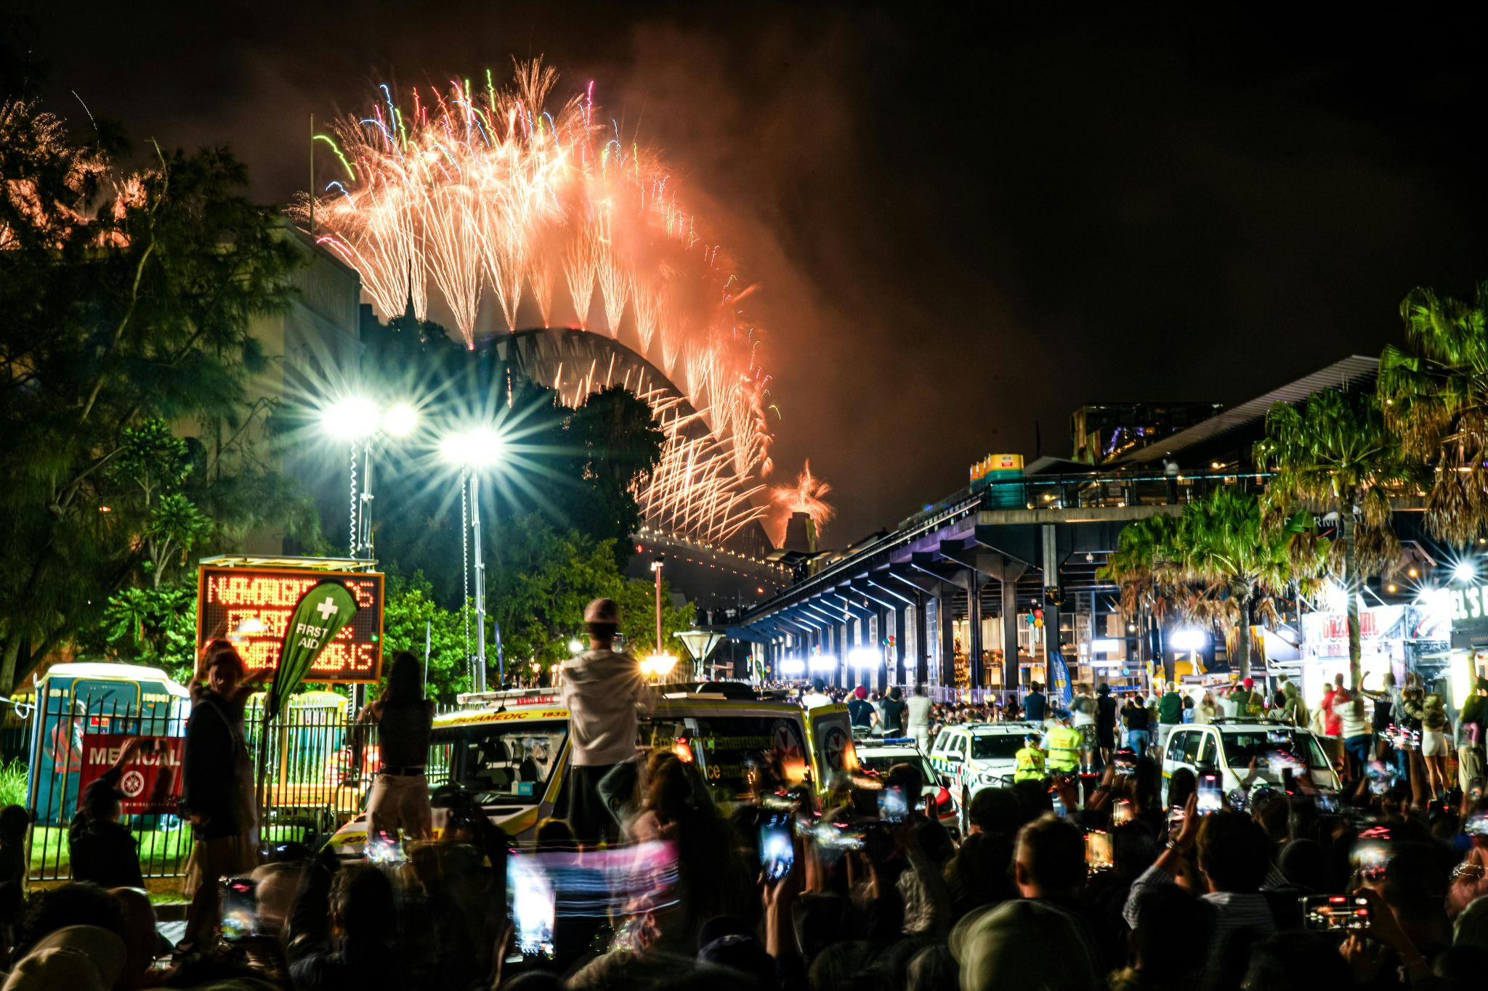
World Refugee Day 2026
A Million Stories
Notes:
Leader: Today we come together for World Refugee Day. This year is a special
celebration in Australia because, since 1947, we have issued one million permanent humanitarian visas. That means we have welcomed people from all parts of the globe, people who have helped to build modern Australia. Each one of them has a story worth sharing, a story of journeying to find hope.
Reader 1: We are all unique, and all have our own story. Today let’s honour every story and
discover how amazing it is when the people behind all these stories come together. Our diversity makes us more colourful and more wonderful.
Leader: We begin with the bigger story of our land. Let us acknowledge the people of its
First Nations.
Photo: Pexels.com

Slide 2
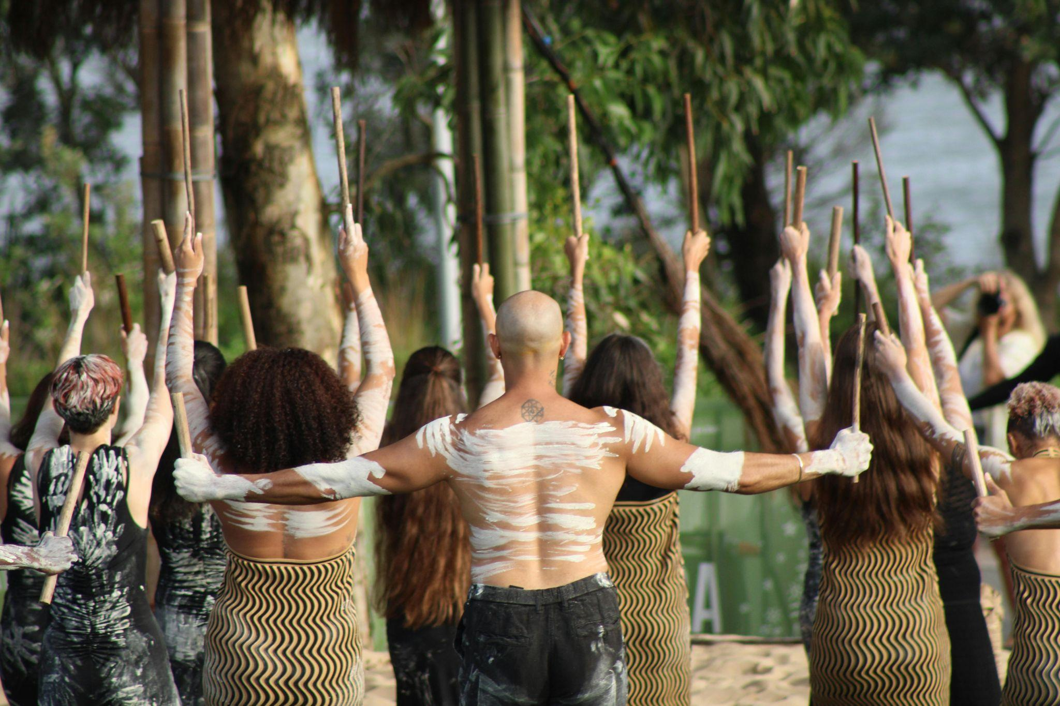
Acknowledgement of Country
Notes:
Reader 2: We acknowledge the millions of stories of First Nations people, who cared for this
land for thousands of generations. They lived in peace across different cultures and languages, trading between each other and walking respectfully on the earth. We acknowledge and show respect for their Elders, who guided the people to keep traditions and extend hospitality to strangers. May we listen and learn from their stories.
Photo: Pexels.com

Slide 3
Sign of the Cross and
Opening Prayer
Response: Amen.
Notes:
Leader: Drawing strength from the story of our faith, let us begin in prayer.
+ In the name of the Father, and of the Son, and of the Holy Spirit.
All: Amen.
Leader: Let us pray … (pause) …
God of all hope,
you hold every person in the palm of your hand.
Help us to value the story of every one of your children.
Through Christ our Lord,
All: Amen.

Slide 4
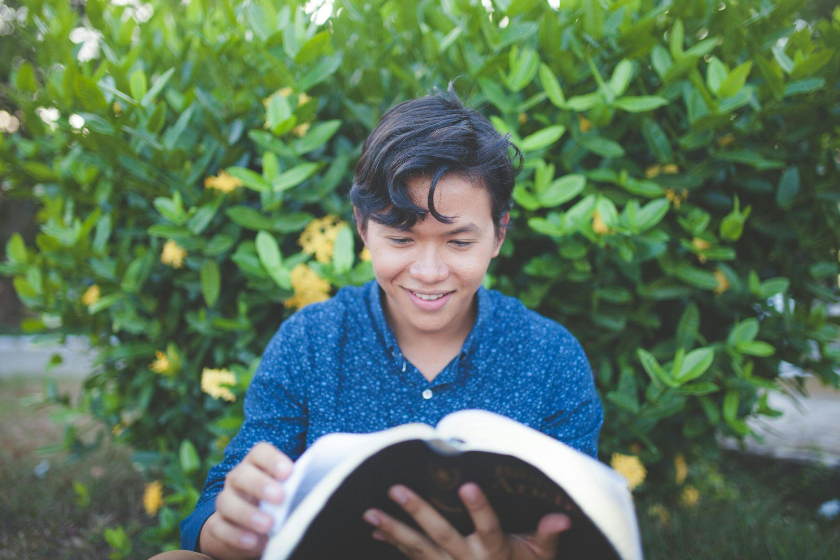
Stories from the Bible
Notes:
Leader: Now we will hear a number of stories from scripture, of people that took a journey
looking for freedom, survival and hope.
Reader 3: My name is Abram and I travelled with my wife Sarai and our family to live a long
way away from where we were born. But just when we had settled in Canaan there was a famine, so we had to leave again to stay in Egypt where there was still food. Later we returned to Canaan and my name was changed to Abraham, which means ‘Father of Many Nations’.
Reader 4: My name is Hagar and I was the Egyptian slave of Sarai. But when I had a son
called Ishmael she became angry with us and forced us to wander in the desert in exile. But God looked out for us and helped us to survive.
Reader 5: My name is Moses and I grew up in Egypt where my people had come when
there was another famine. But we became slaves there and so God called me to lead them to our own Promised Land where we could be free. However, to get there, we had to wander through the desert as refugees for 40 years. It was a very hard journey.
Reader 6: My name is Naomi and I had to take my family to Moab because of the famine at
home. My sons got married there, but they died. When I wanted to return home, one daughter-in-law stayed, but the other came with me, leaving everything she knew behind. I am so grateful for Ruth’s love and friendship.
Reader 7: My name is Joseph and King Herod wanted to kill all the boy babies in
Bethlehem. I ran away as soon as I could to protect my wife Mary and my foster-child. But I am so glad we went to Egypt where we were safe. Otherwise you would not know about our child - his name was Jesus.
… (pause) …
Photo: Pexels.com

Slide 5
Video: https://vimeo.com/127320460?fl=pl&fe=vl
Notes:
Leader: As part of our listening time, we will also hear a little of some of the stories of
people who have had a refugee journey to come to Australia.
[Watch Freedom Stories – 90sec Trailer | Videos & Movies on Vimeo or Freedom Stories – 3min Trailer | Videos & Movies on Vimeo]

Slide 6
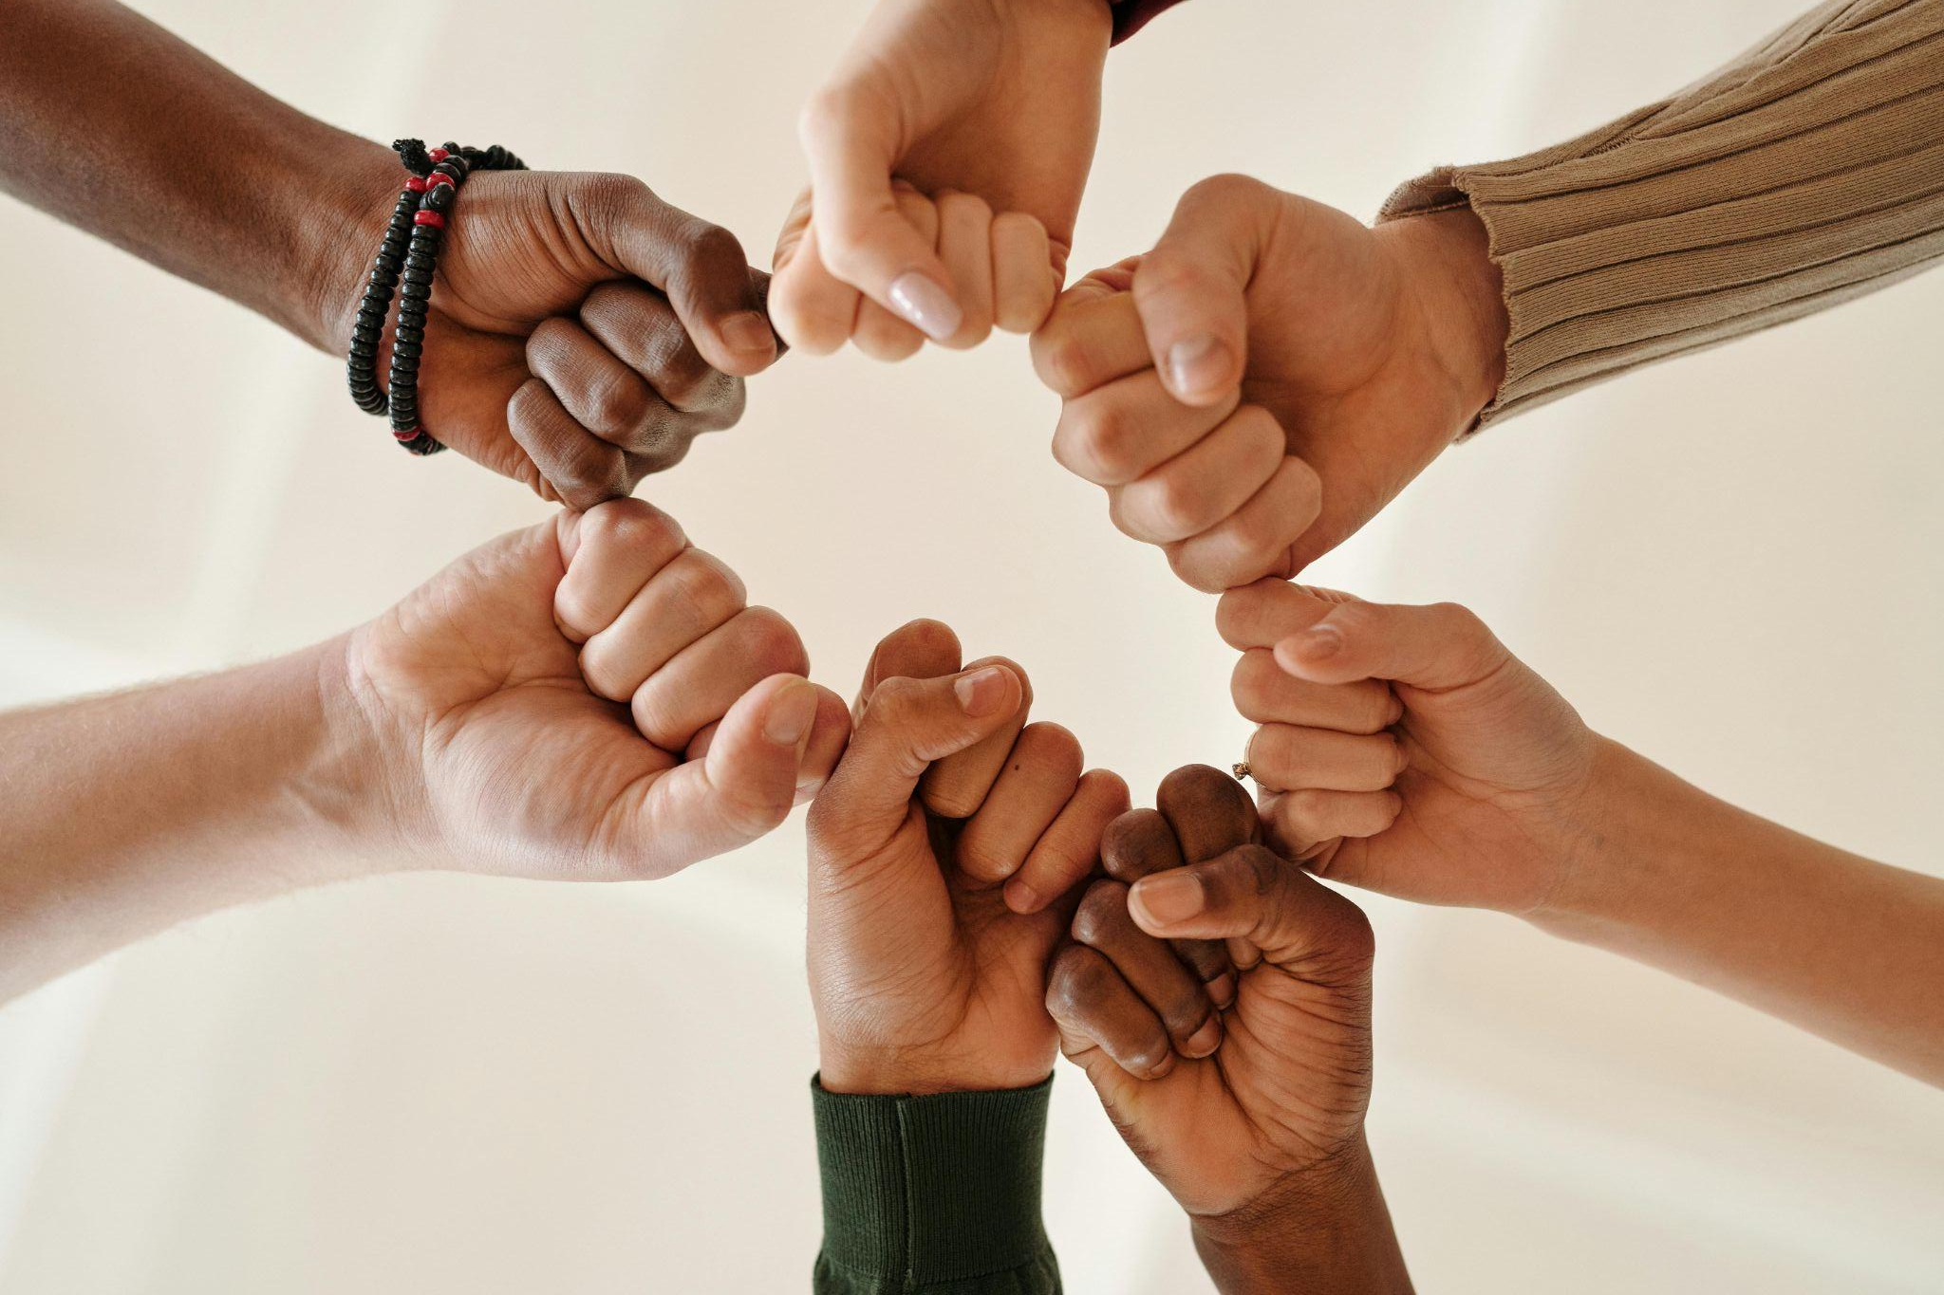
Responding in Prayer
…Let us pray.
Response:
God of all people, hear our prayer.
Notes:
Leader: God asks us to love the strangers as God does. Let us pray for the strength to
create a welcoming society of diversity for all. Our response to each prayer is ‘God of all people, hear our prayer’.
Reader 4: [Holding sign saying ‘Finding’] For those still finding a way, who don’t know where
they will sleep tonight or where they can be safe. May they find what they need to survive. Let us pray.
All: God of all people, hear our prayer.
Reader 5: [Holding sign saying ‘Freedom’] For our political leaders. May they allow all
people to live with freedom, no matter their race, ethnicity, gender, religion, disability or sexuality. Let us pray.
All: God of all people, hear our prayer.
Reader 6: [Holding sign saying ‘Diversity’] For ourselves. May we value and celebrate the
diversity among us, always welcoming every unique person. Let us pray.
All: God of all people, hear our prayer.
Reader 7: [Holding sign saying ‘Community’] For our school community. May we find
strength in our diversity, and promote justice for all who are oppressed. Let us
pray.
All: God of all people, hear our prayer.

Slide 7
Responding in Prayer
…Let us pray.
Response:
God of hope, hear our prayer.
Notes:
Leader: Every person is made in the image and likeness of God. Let us ask our God to
help us value every story. Our response to each prayer is ‘God of hope, hear our prayer’.
Reader 8: For every person who has had to flee from their home to survive and live in
dignity.
May we listen to their stories and may they experience welcome and hope. Let us pray.
All: God of hope, hear our prayer.
Reader 9: For our political and civil leaders.
May they create pathways for people to find a home and the support that they need. Let us pray.
All: God of hope, hear our prayer.
Reader 10: For all of us.
May we value every story, highlight people’s strengths and celebrate our cultural diversity. Let us pray.
All: God of hope, hear our prayer.

Slide 8
Our Father who art in heaven,
hallowed be thy name.
Thy kingdom come.
Thy will be done
on earth, as it is in heaven.
Give us this day
our daily bread,
Notes:
Leader: And as a school community of many stories united under one God, let us pray
together in the words that Jesus taught us:
All: Our Father…

Slide 9
And forgive us our trespasses, as we forgive those who trespass against us.
And lead us not into temptation, but deliver us from evil.
Amen.

Slide 10
May the God of endurance and encouragement
grant us to live in such harmony with one another,
in accord with Christ Jesus,
that together we may with one voice
glorify the God and Father of our Lord Jesus Christ.
May we welcome one another as Christ has welcomed each one of us,
for the glory of God.
Amen.
Notes:
Leader: So let us conclude together with a prayer adapted from St Paul’s Letter to the
Romans [15:5-7]:
All: May the God of endurance and encouragement
grant us to live in such harmony with one another,
in accord with Christ Jesus,
that together we may with one voice
glorify the God and Father of our Lord Jesus Christ.
May we welcome one another as Christ has welcomed each one of us,
for the glory of God.
Amen.

Slide 11
Blessing and Sign of the Cross
Response: Amen.
Response:
Thanks be to God!
Notes:
Leader: May the Creator of all people bless us,
All: Amen.
Leader: May the Saviour of the world bless us,
All: Amen.
Leader: May the Spirit of all life bless us,
All: Amen.
Leader: And may our God bless us, + the Father, the Son, and the Holy Spirit.
All: Amen.
Leader: Let us go in peace to love and serve the world.
All: Thanks be to God!

Slide 12


Slide 13
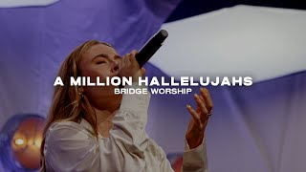

Slide 14
World Refugee Day 2026
A Million Stories

