Slide 1
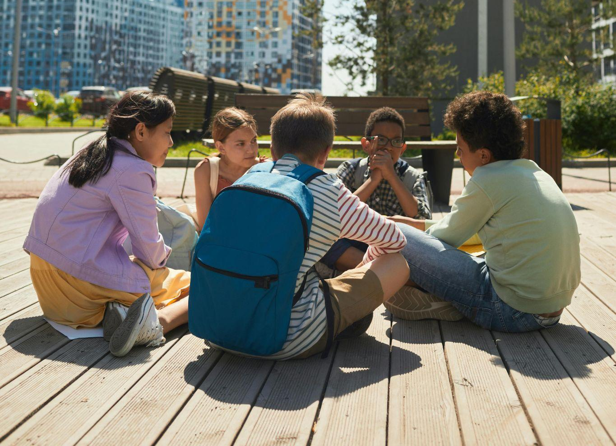
World Refugee Day 2026
A Million Stories
Notes:
Leader: Today we come together for World Refugee Day. This year is a special
celebration in Australia because one million refugees have made our country home. We have welcomed people from all around the world, people who have helped to build Australia as it is today. Each one of them has a story to share, a story of a journey to find hope.
Reader 1: We are all unique, and all have our own story. Today let’s celebrate every story
and find how amazing it is when the people behind all these stories come together. Being different makes us more colourful and more wonderful.
Photo: Pexels.com

Slide 2
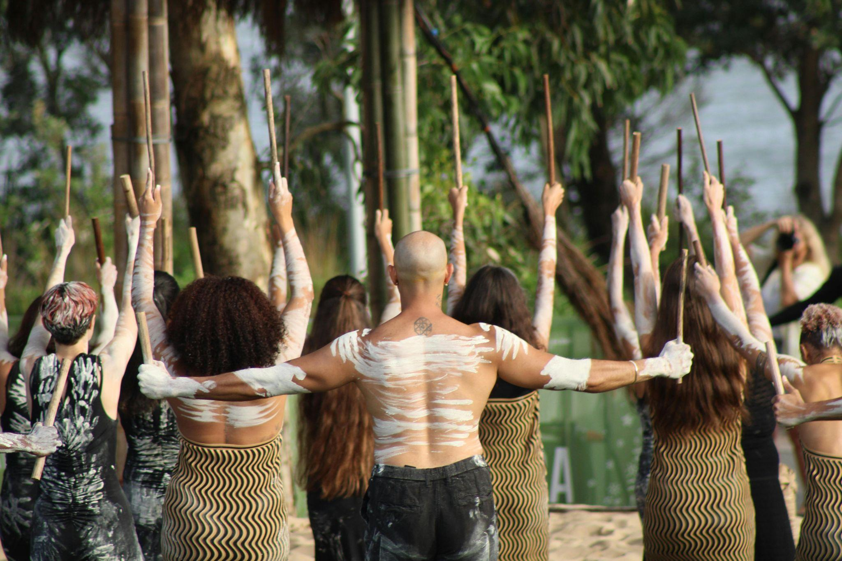
Acknowledgement of Country
Notes:
Leader: We begin with the bigger story of our land. Let us acknowledge the people of its
First Nations.
Reader 2: We acknowledge the millions of stories of First Nations people, who cared for this
land for thousands of generations. Across different cultures and languages, they lived in peace, traded and treated the earth with respect. We acknowledge and show respect for their Elders, who guided the people to keep traditions and share with strangers. May we listen and learn from their stories.
Photo: Pexels.com

Slide 3
Sign of the Cross and Opening Prayer
Response: Amen.
Notes:
Leader: Drawing strength from the story of our faith, let us begin in prayer.
+ In the name of the Father, and of the Son, and of the Holy Spirit.
All: Amen.
Leader: Let us pray … (pause) …
God of all hope,
you hold every person in the palm of your hand.
Help us to value the story of every one of your children.
Through Christ our Lord,
All: Amen.

Slide 4
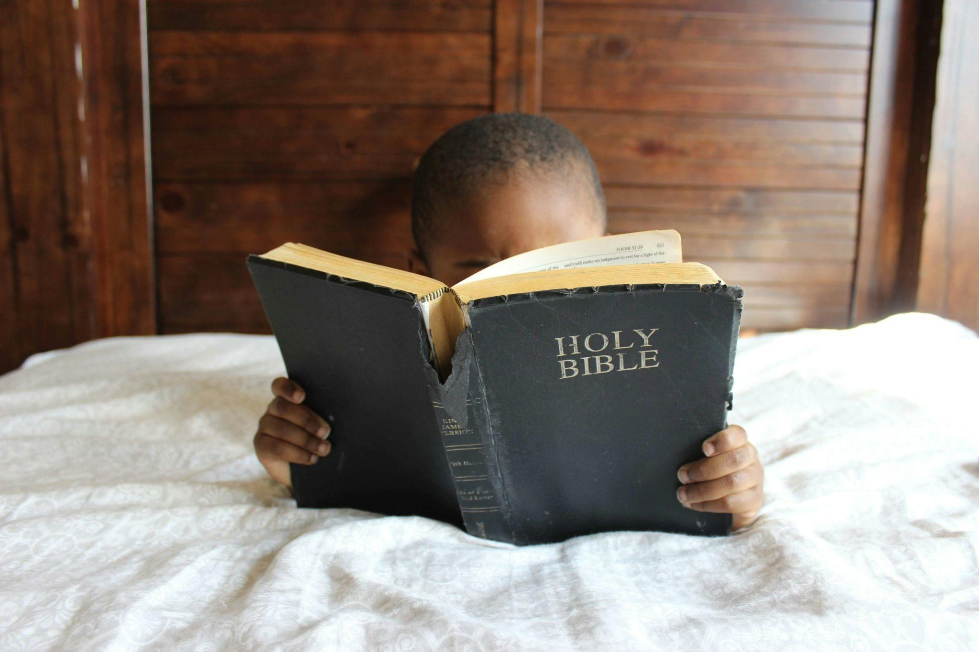
Stories from the Bible
Notes:
Leader: Now we will hear a number of stories from the bible, of people that took a journey
looking for freedom, survival and hope.
Scripture Stories [Choose 2-5 of these stories]
Reader 3: My name is Abram and I travelled with my wife Sarai and our family to live a long
way away from where we were born. But just when we had settled in Canaan there was a famine, so we had to leave again to stay in Egypt where there was still food. Later we returned to Canaan and my name was changed to Abraham, which means ‘Father of Many Nations’.
Reader 4: My name is Hagar and I was the Egyptian slave of Sarai. But when I had a son
called Ishmael she became angry with us and forced us to wander in the desert in exile. But God looked out for us and helped us to survive.
Reader 5: My name is Moses and I grew up in Egypt where my people had come when
there was another famine. But we became slaves there and so God called me to lead them to our own Promised Land where we could be free. However, to get there, we had to wander through the desert as refugees for 40 years. It was a very hard journey.
Reader 6: My name is Naomi and I had to take my family to Moab because of the famine at
home. My sons got married there, but they died. When I wanted to return home, one daughter-in-law stayed, but the other came with me, leaving everything she knew behind. I am so grateful for Ruth’s love and friendship.
Reader 7: My name is Joseph and King Herod wanted to kill all the boy babies in
Bethlehem. I ran away as soon as I could to protect my wife Mary and my foster-child. But I am so glad we went to Egypt where we were safe. Otherwise you would not know about our child - his name was Jesus.
… (pause) …
Photo: Pexels.com

Slide 5

Notes:
Leader: As part of our listening time, we will also hear a little of some of the stories of
people who have had a refugee journey to come to Australia.

Slide 6
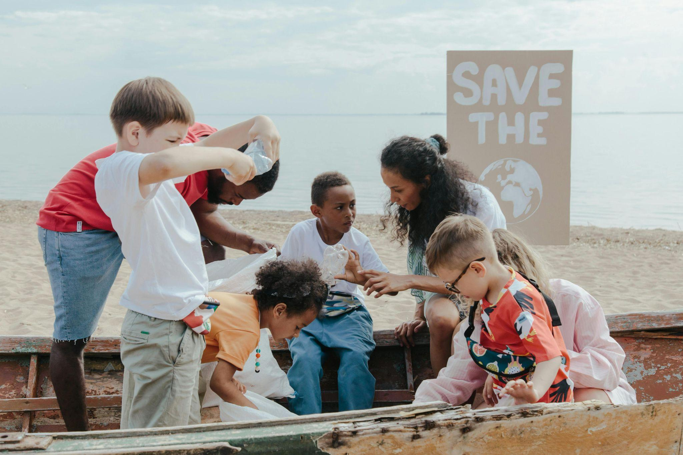
Responding in Prayer
…Let us pray.
Response:
God of all, hear our prayer.
Notes:
Leader: God asks us to love the strangers as God does. Let us pray that we might be a
place of welcome for all different people. Our response to each prayer is ‘God of all, hear our prayer’.
Reader 4: [Holding sign saying ‘Finding’] For those who are finding a way, who don’t know
where they will sleep tonight or where they can be safe. May they find what they need to live. Let us pray.
All: God of all, hear our prayer.
Reader 5: [Holding sign saying ‘Freedom’] For our leaders. May they let all people live with
freedom, no matter who they are, what they look like or what they believe. Let us pray.
All: God of all, hear our prayer.
Reader 6: [Holding sign saying ‘Diversity’] For ourselves. May we celebrate our diversity,
and welcome each person. Let us pray.
All: God of all, hear our prayer.
Reader 7: [Holding sign saying ‘Community’] For our school community. May we be
stronger because we include everyone. Let us pray.
All: God of all, hear our prayer.

Slide 7
Responding in Prayer
…Let us pray.
Response: God of hope, hear our prayer.
Notes:
Leader: Every person is made in the image and likeness of God. Let us ask our God to
help us value every story. Our response to each prayer is ‘God of hope, hear our prayer’.
Reader 8: For every person who has had to flee from their home to live and be safe.
May we hear their stories and may they have welcome and hope. Let us pray.
All: God of hope, hear our prayer.
Reader 9: For the leaders in our country.
May they create pathways for people to find a home and the support that they need. Let us pray.
All: God of hope, hear our prayer.
Reader 10: For all of us.
May we value every story, highlight people’s strengths and celebrate our cultural diversity. Let us pray.
All: God of hope, hear our prayer.

Slide 8
Our Father who art in heaven,
hallowed be thy name.
Thy kingdom come.
Thy will be done
on earth, as it is in heaven.
Give us this day
our daily bread,
Notes:
Leader: And as a school community of many stories united under one God, let us pray
together in the words that Jesus taught us:
All: Our Father…

Slide 9
And forgive us our trespasses, as we forgive those who trespass against us.
And lead us not into temptation, but deliver us from evil.
Amen.

Slide 10
May the God of patience and encouragement
grant us to live in such harmony with one another,
along with Christ Jesus,
that together we may with one voice
give glory to God the Father of our Lord Jesus Christ.
May we welcome one another as Christ has welcomed each one of us,
for the glory of God.
Amen.
Notes:
Leader: So let us conclude together with a prayer adapted from St Paul’s Letter to the
Romans [15:5-7]:
All: May the God of patience and encouragement
grant us to live in such harmony with one another,
along with Christ Jesus,
that together we may with one voice
give glory to God the Father of our Lord Jesus Christ.
May we welcome one another as Christ has welcomed each one of us,
for the glory of God.
Amen.

Slide 11
Blessing and Sign of the Cross
Response: Amen.
Response: Thanks be to God!
Notes:
Leader: May the Creator of all people bless us,
All: Amen.
Leader: May the Saviour of the world bless us,
All: Amen.
Leader: May the Spirit of all life bless us,
All: Amen.
Leader: And may our God bless us, + the Father, the Son, and the Holy Spirit.
All: Amen.
Leader: Let us go in peace to love and serve the world.
All: Thanks be to God!

Slide 12


Slide 13
World Refugee Day 2026
A Million Stories

