Slide 1
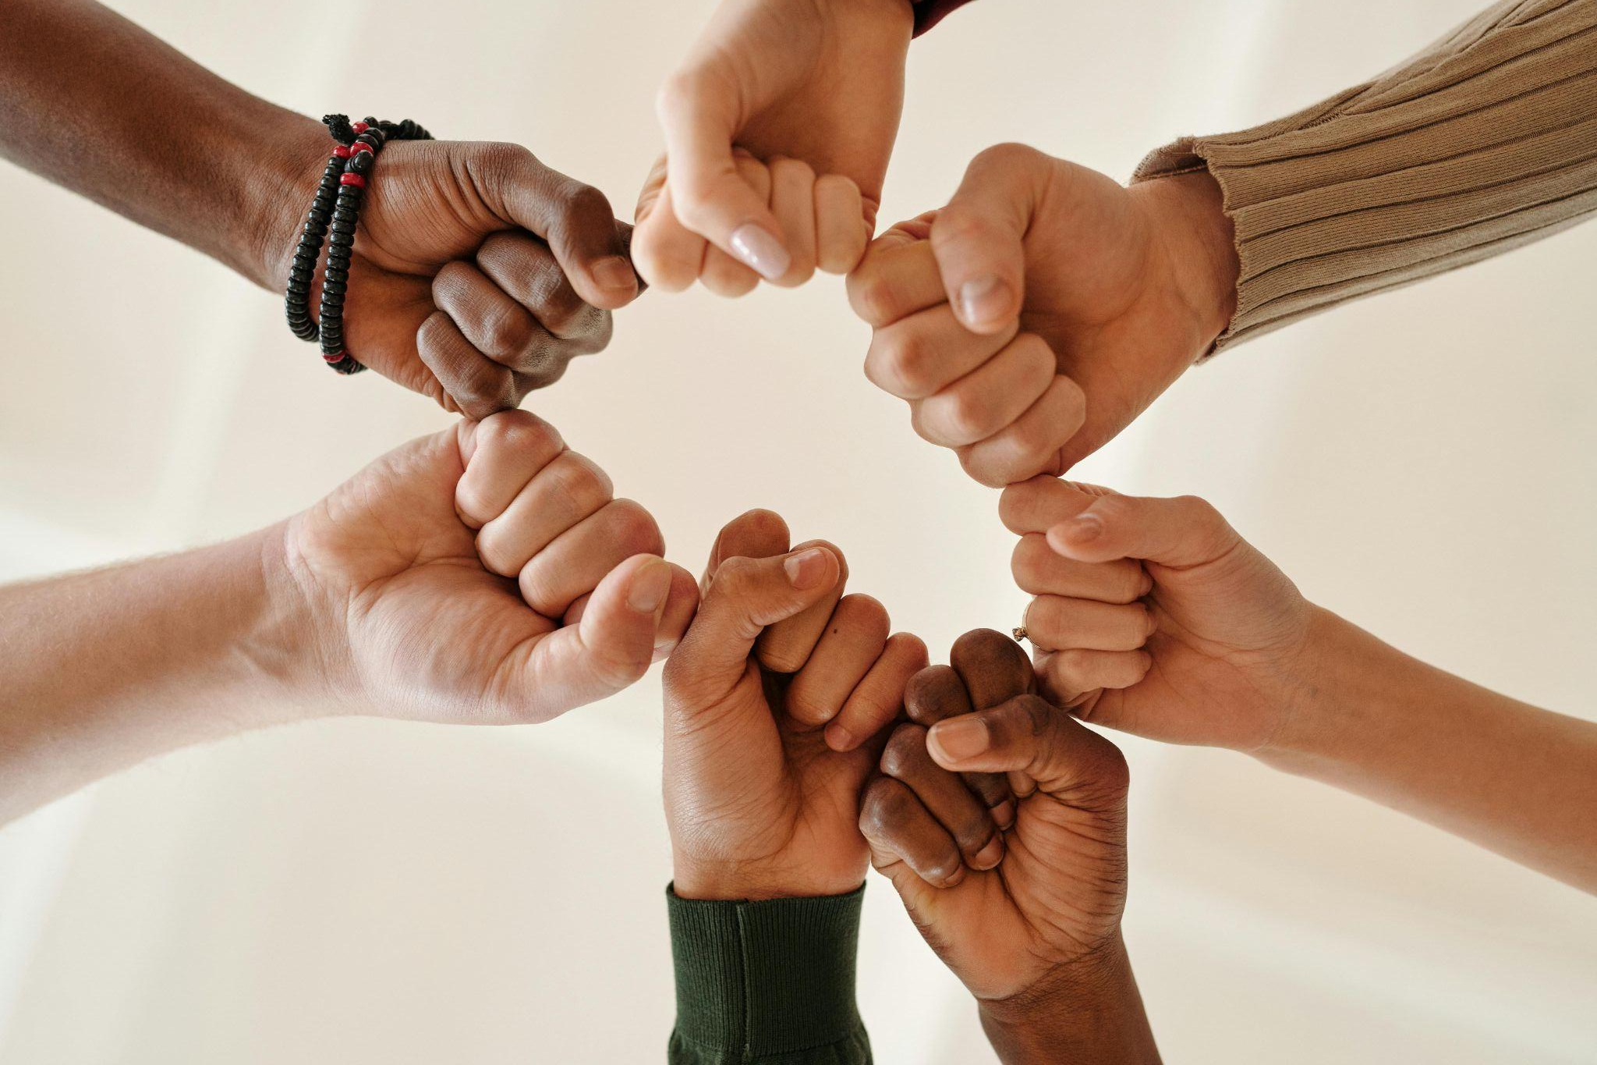
World Refugee Day 2025
Finding Freedom: Diversity in Community
Notes:
Leader: Today we come together for World Refugee Day. And it’s a day to celebrate!
Because all our lives are better because we live with people who have been refugees. I will repeat: all our lives are better because we live with people who have been refugees.
Reader 1: It’s not good to leave your home country. It’s not good to be forced to find
safety. Wars, persecution and environmental destruction are really not good. But
if you find freedom, it means everything. It means life and safety and hope. You are part of a new community. And the thing is, that’s good for everyone. By hosting refugees, the whole community becomes more diverse and a better place for all of us.
Leader: Let’s celebrate the diversity and inclusion of our community. Our differences
make us stronger, more united, and more capable of facing challenges. In a welcoming community, we are able to solve problems together, raise voices, feel personally safe and empower each other to pursue our dreams.
We will first hear from those who have been on a refugee journey.

Slide 2
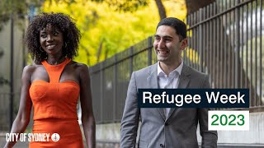

Slide 3
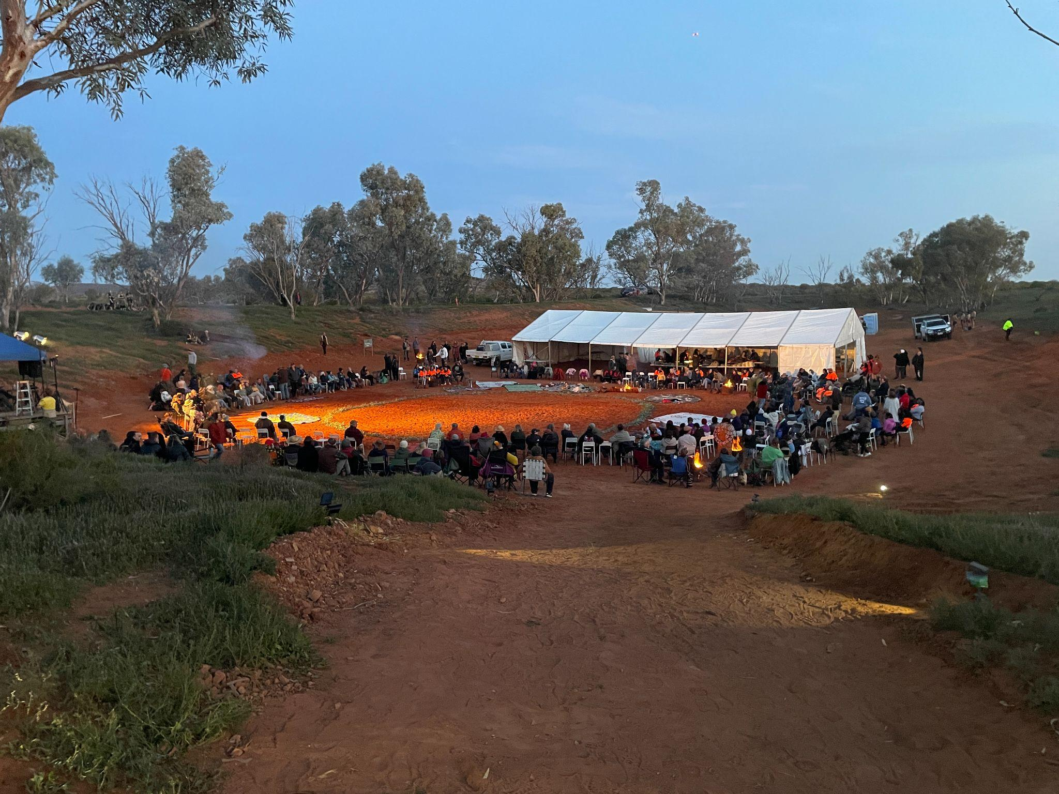
Acknowledgement
of Country
Notes:
So as we remember the diversity among us, let us acknowledge the First Peoples of this land.
Reader 2: We acknowledge the many peoples who inhabited this country, with
their different cultures, languages and stories. We acknowledge their ability to share the resources of the land without taking too much, and for respecting the people and ancestors when they visited other areas. May we also show respect to all Elders, past, present and emerging. May we come together with our First Nations to listen and find ways forward for justice and peace together.

Slide 4
Sign of the Cross and
Opening Prayer
Response: Amen.
Notes:
Leader: As we begin in prayer, we remember God’s call to us to be communities of
welcome for all.
+ In the name of the Father, and of the Son, and of the Holy Spirit.
All: Amen.
Leader: Let us pray … (pause) …
God of all people,
you delight in the diversity of our world.
Help us to be like you, and welcome the stranger among us.
We ask this through Christ our Lord,
All: Amen.

Slide 5
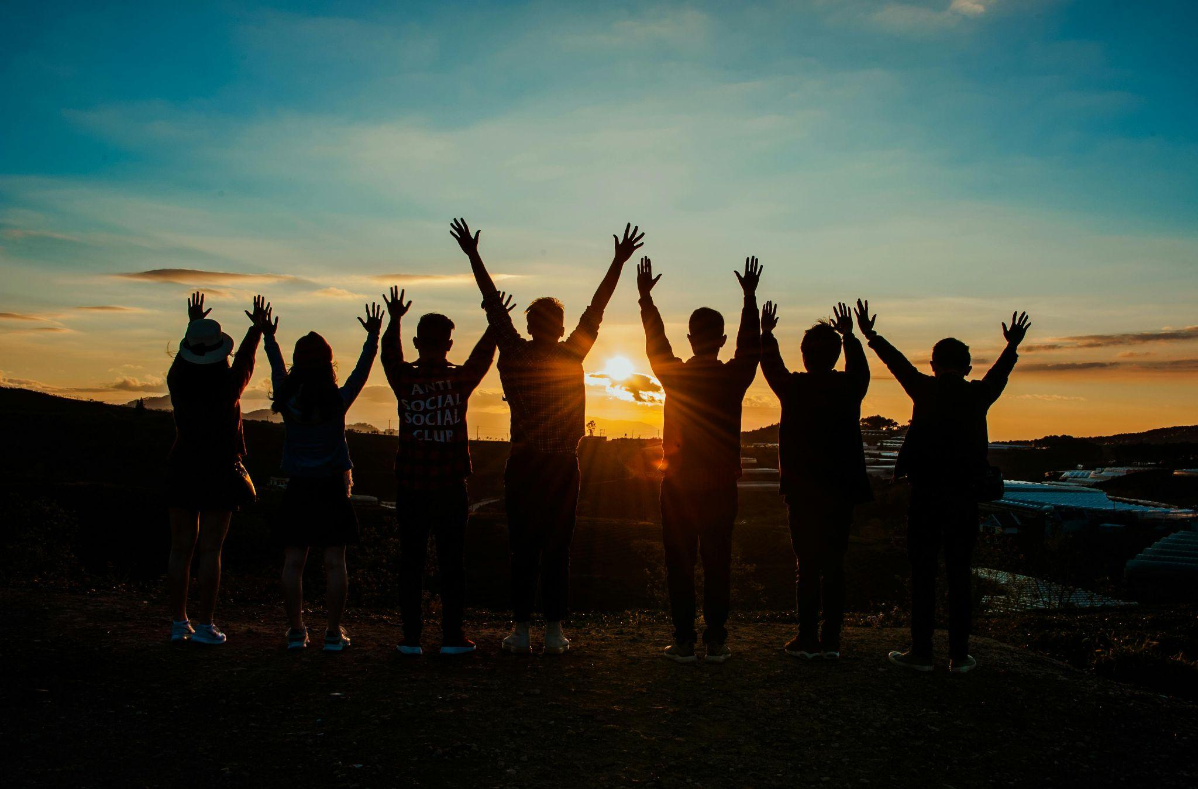
Reading: Deuteronomy 10:12-13, 17-19
Notes:
Leader: Now let us listen to a passage from the Old Testament. It was written to the
Israelite people after they had fled from slavery in Egypt to the Promised Land.
Scripture
Reader 3: A reading from the Book of Deuteronomy [10:12-13, 17-19, NRSV].
So now, O Israel, what does the Lord your God require of you? Only to fear the
Lord your God, to walk in all his ways, to love him, to serve the Lord your God with all your heart and with all your soul, and to keep the commandments of the Lord your God and his decrees that I am commanding you today, for your own well-being.
For the Lord your God is God of gods and Lord of lords, the great God, mighty and awesome, who is not partial and takes no bribe, who executes justice for the orphan and the widow, and who loves the strangers, providing them with food and clothing. You shall also love the stranger, for you were strangers in the land of Egypt.

Slide 6
Responding in Prayer
…Let us pray.
Response:
God of all people, hear our prayer.
Notes:
Leader: God asks us to love the strangers as God does. Let us pray for the strength to
create a welcoming society of diversity for all. Our response to each prayer is ‘God of all people, hear our prayer’.
Reader 4: [Holding sign saying ‘Finding’] For those still finding a way, who don’t know where
they will sleep tonight or where they can be safe. May they find what they need to survive. Let us pray.
All: God of all people, hear our prayer.
Reader 5: [Holding sign saying ‘Freedom’] For our political leaders. May they allow all
people to live with freedom, no matter their race, ethnicity, gender, religion, disability or sexuality. Let us pray.
All: God of all people, hear our prayer.
Reader 6: [Holding sign saying ‘Diversity’] For ourselves. May we value and celebrate the
diversity among us, always welcoming every unique person. Let us pray.
All: God of all people, hear our prayer.
Reader 7: [Holding sign saying ‘Community’] For our school community. May we find
strength in our diversity, and promote justice for all who are oppressed. Let us
pray.
All: God of all people, hear our prayer.

Slide 7
Our Father who art in heaven,
hallowed be thy name.
Thy kingdom come.
Thy will be done
on earth, as it is in heaven.
Give us this day
our daily bread,
Notes:
Leader: And let us pray together in the words that Jesus taught us:

Slide 8
Help us to keep walking,
together with our migrant brothers and sisters,
toward the eternal dwelling you have prepared for us.
Open our eyes and our hearts
so that every encounter with those in need
becomes an encounter with Jesus, your Son and our Lord.
Amen.

Slide 9
(Prayer from Pope Francis)
Let us pray that migrants fleeing from war or hunger,
forced to undertake journeys fraught with danger and violence,
may find welcome and new living opportunities.
Amen.
Notes:
Leader: So let us conclude together with a prayer of Pope Francis:*
All: Let us pray that migrants fleeing from war or hunger,
forced to undertake journeys fraught with danger and violence,
may find welcome and new living opportunities.
Amen.

Slide 10
Blessing and Sign of the Cross
Response: Amen.
Response:
Thanks be to God!
Notes:
Leader: May our God bless us, who is diversity in community; three in one and one in
three. In the name of the + Father, the Son, and the Holy Spirit.
All: Amen.
Leader: Let us go in justice and peace.
All: Thanks be to God!

Slide 11
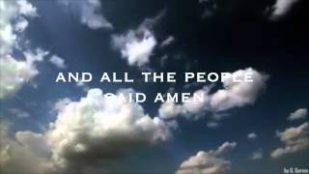

Slide 12
World Refugee Day 2025
Finding Freedom: Diversity in Community

