Slide 1
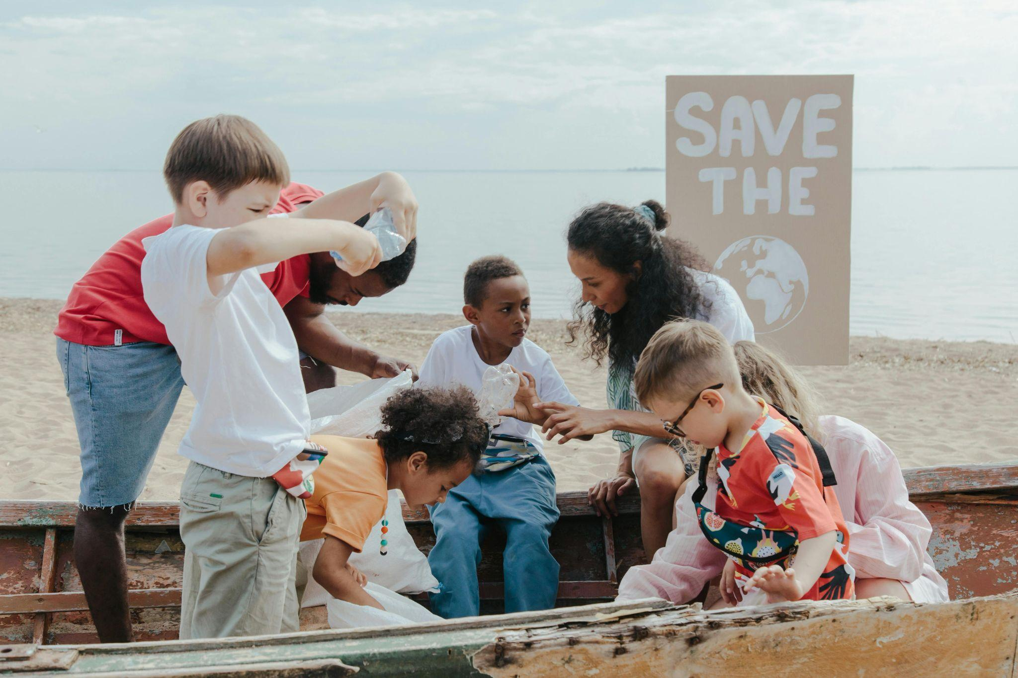
World Refugee Day 2025
Finding Freedom: Diversity in Community
Notes:
Leader: Today we come together for World Refugee Day. So let’s celebrate! Because all
our lives are better because of refugees. I will repeat: all our lives are better
because of refugees.
Reader 1: Some people are forced to leave their home countries because of war, disasters
or suffering. That’s not good. They risk everything to find freedom. But when they join our community, it is good for us. We become more diverse and a better place for everyone.
Leader: Let’s celebrate our differences. They make us stronger, more united, and more
able to face our challenges together. We welcome each person to feel safe and to follow their dreams.
We will first hear from those who have been on a refugee journey.

Slide 2


Slide 3
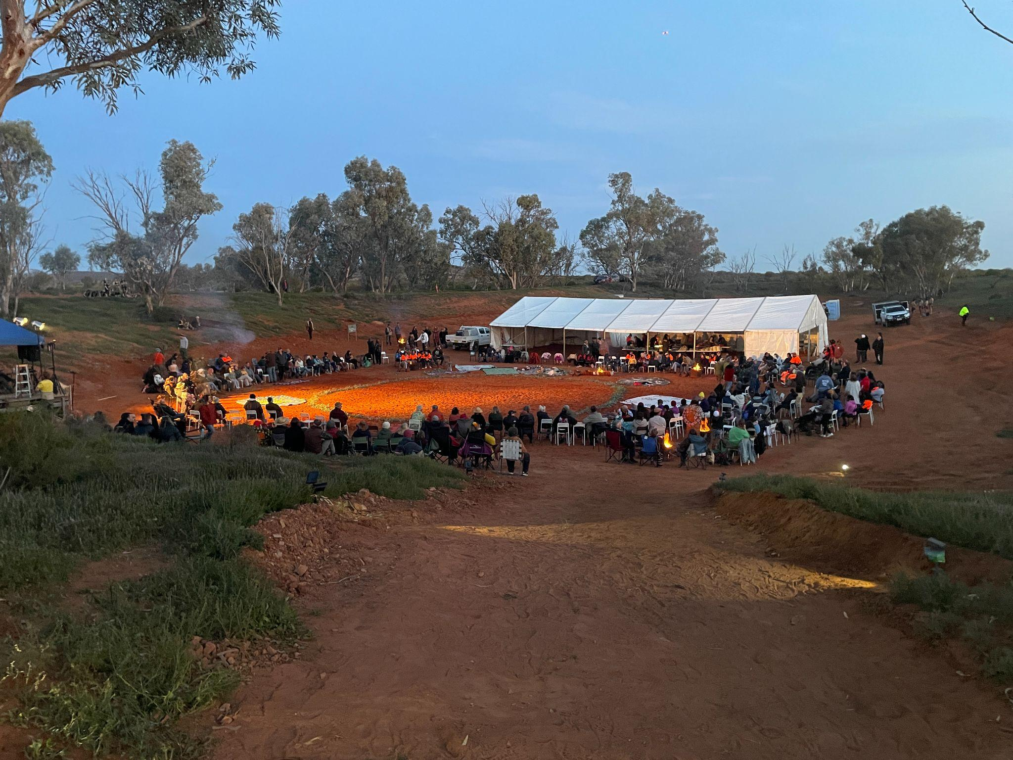
Acknowledgement
of Country
Notes:
Let us also celebrate and acknowledge the First Peoples of this land.
Reader 2: We acknowledge the many peoples who lived in this country, with their different
cultures, languages and stories. They shared without taking too much from the land, and respected each other and the ancestors. May we also show respect to all Elders. May we listen to our First Nations and find justice and peace together.

Slide 4
Sign of the Cross and
Opening Prayer
Response: Amen.
Notes:
Leader: As we begin in prayer, we remember God’s call to welcome all people.
+ In the name of the Father, and of the Son, and of the Holy Spirit.
All: Amen.
Opening Prayer
Leader: Let us pray … (pause) …
God of all people,
you love all the differences in our world.
Help us to be like you, and welcome each new person with joy.
We ask this through Christ our Lord,
All: Amen.

Slide 5
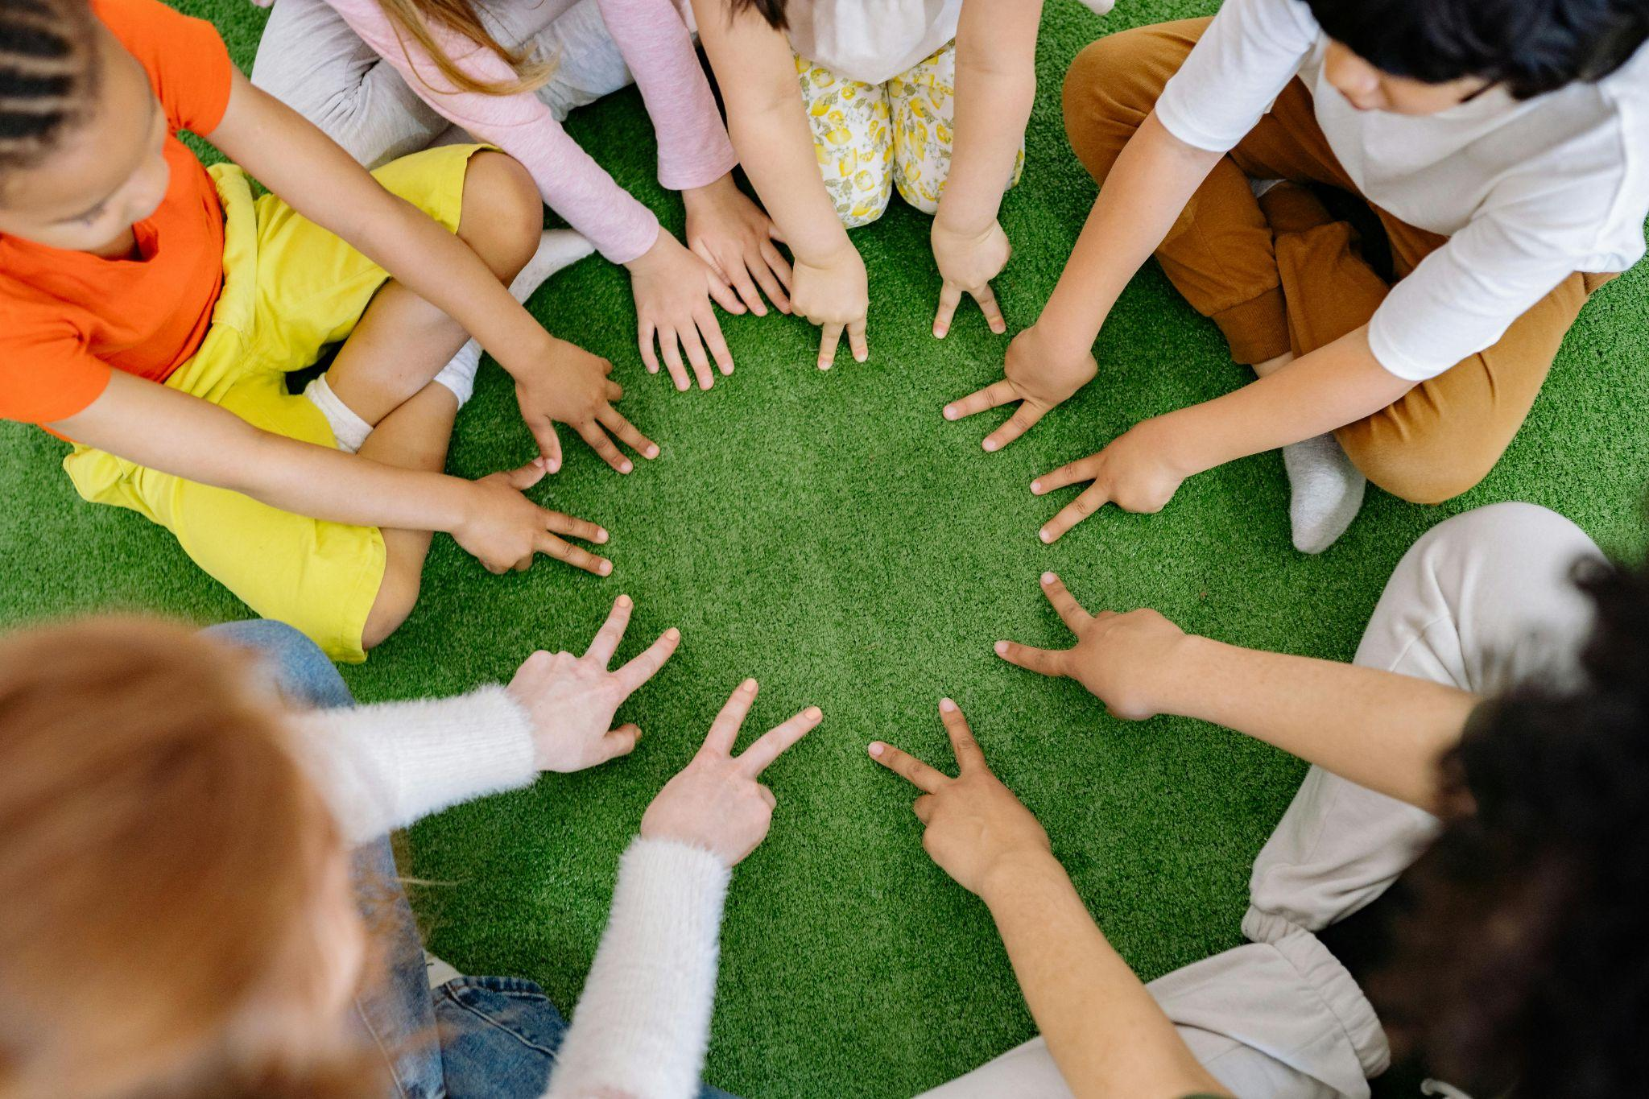
Reading: Deuteronomy 10:17-19
Notes:
Leader: Now let us listen to the Old Testament. It was written to the Israelite people after
they had escaped from slavery in Egypt to the Promised Land.
Scripture
Reader 3: A reading from the Book of Deuteronomy [10:17-19, NRSV].
For the Lord your God is God of gods and Lord of lords, the great God, mighty
and awesome, who is not partial and takes no bribe, who executes justice for the orphan and the widow, and who loves the strangers, providing them with food and clothing. You shall also love the stranger, for you were strangers in the land of Egypt.

Slide 6
Responding in Prayer
…Let us pray.
Response:
God of all, hear our prayer.
Notes:
Leader: God asks us to love the strangers as God does. Let us pray that we might be a
place of welcome for all different people. Our response to each prayer is ‘God of all, hear our prayer’.
Reader 4: [Holding sign saying ‘Finding’] For those who are finding a way, who don’t know
where they will sleep tonight or where they can be safe. May they find what they need to live. Let us pray.
All: God of all, hear our prayer.
Reader 5: [Holding sign saying ‘Freedom’] For our leaders. May they let all people live with
freedom, no matter who they are, what they look like or what they believe. Let us pray.
All: God of all, hear our prayer.
Reader 6: [Holding sign saying ‘Diversity’] For ourselves. May we celebrate our diversity,
and welcome each person. Let us pray.
All: God of all, hear our prayer.
Reader 7: [Holding sign saying ‘Community’] For our school community. May we be
stronger because we include everyone. Let us pray.
All: God of all, hear our prayer.

Slide 7
Our Father who art in heaven,
hallowed be thy name.
Thy kingdom come.
Thy will be done
on earth, as it is in heaven.
Give us this day
our daily bread,
Notes:
Leader: And let us pray together in the words that Jesus taught us:

Slide 8
Help us to keep walking,
together with our migrant brothers and sisters,
toward the eternal dwelling you have prepared for us.
Open our eyes and our hearts
so that every encounter with those in need
becomes an encounter with Jesus, your Son and our Lord.
Amen.

Slide 9
(Prayer from Pope Francis)
Merciful God, we pray to you for all in search of a better life.
May we seek a world where none are forced to leave their home
and where all can live in freedom, dignity and peace.
Amen.
Notes:
Leader: So let us end together with a prayer of Pope Francis:*
All: Merciful God, we pray to you for all in search of a better life.
May we seek a world where none are forced to leave their home
and where all can live in freedom, dignity and peace.
Amen.

Slide 10
Blessing and Sign of the Cross
Response: Amen.
Response:
Thanks be to God!
Notes:
Leader: May our God bless us, who is three in one and one in three. In the name of the +
Father, the Son, and the Holy Spirit.
All: Amen.
Leader: Let us go in justice and peace.
All: Thanks be to God!

Slide 11
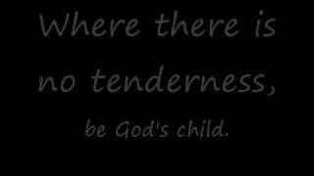

Slide 12
World Refugee Day 2025
Finding Freedom: Diversity in Community

