Slide 1

RESPONDING TO CURRENT AUSTRALIAN REFUGEE POLICY
Paul Power
CEO, Refugee Council of Australia
6 December 2012

Slide 2
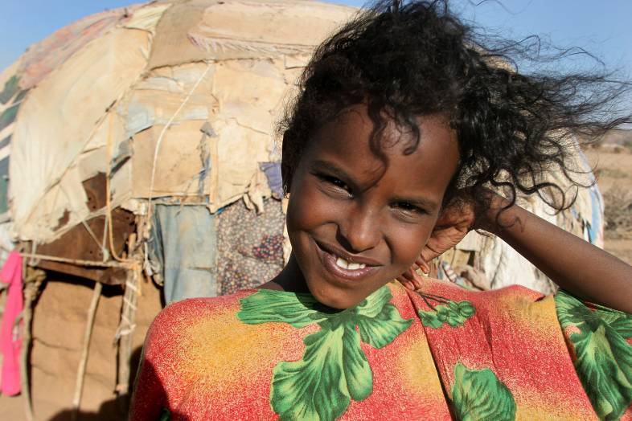
Refugees and their rights
Photo: UNHCR

Slide 3
Refugees and their rights
A refugee is a person with “a well founded fear of being persecuted for reasons of race, religion, nationality, membership of a particular social group or political opinion” who is outside their country of nationality and unable or unwilling to return
Rights of refugees under the 1951 Refugee Convention and 1967 Protocol:
Protection from refoulement – return to country where they face threats to life or freedom (Article 33)
Right not to be expelled, except on grounds of national security or public order (32), not to be punished for illegal entry (31), to access the courts (16), to be issued identity & travel documents (27-28)
Right to work (17-19), housing (21), education (22), public relief and assistance (23), freedom of religion (4), freedom of movement within the territory (26)

Slide 4
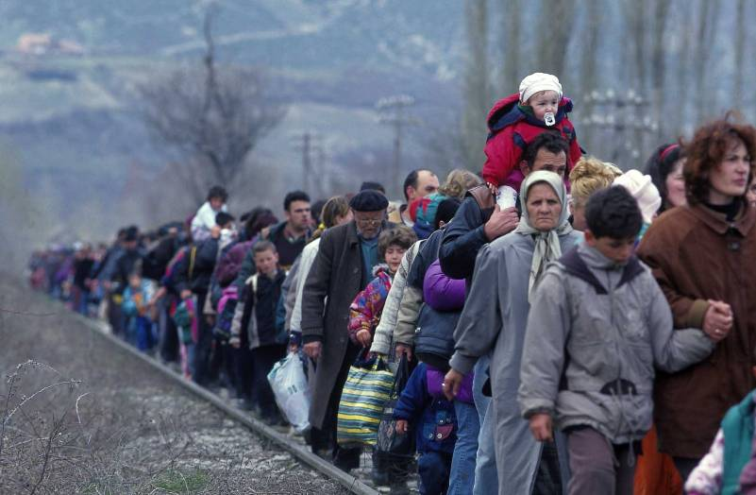
Global refugee situation
Photo: UNHCR

Slide 5
Refugees as at December 2011
15.2 million refugees in the world in 2011:
10.4 million under UNHCR
4.8 million Palestinian refugees under UNRWA
Around 895,000 asylum seekers
Of 10.4 million UNHCR-mandate refugees:
One-third in camps; more than half in urban areas
Four-fifths in developing countries
Three-quarters in a country neighbouring their own
Top 3 source countries: Afghanistan (2,664,436), Iraq (1,428,308), Somalia (1,077,048)
Top 3 host countries: Pakistan (1,702,700), Iran (886,468). Syria (755,445)

Slide 6
Are durable solutions working?
Voluntary repatriation – Been in decline since 2004 – just 197,600 refugees returned home in 2010 (lowest in 20 years) and 532,000 in 2011
Integration – Few countries of asylum outside Europe and North America offer permanent residency or citizenship to refugees – a rare exception being 2010 decision of Tanzania to offer citizenship to 162,000 Burundians
Resettlement – Declined from 151,772 in 1994 to 50,571 in 2002 and 79,784 in 2011 – just 0.77% of UNHCR mandated refugees resettled last year (one in every 130)
Now 7.2 million people are in protracted refugee situations (displaced +5 years) – 69% of all UNHCR mandated refugees. Average length of displacement close to 20 years
As durable solutions continue to fail, more refugees choose to move on to seek greater protection

Slide 7
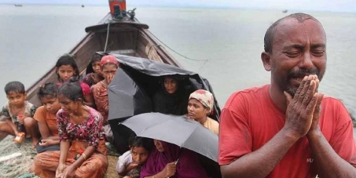
Refugee protection in the Asia-Pacific region
Photo: BdNews24

Slide 8
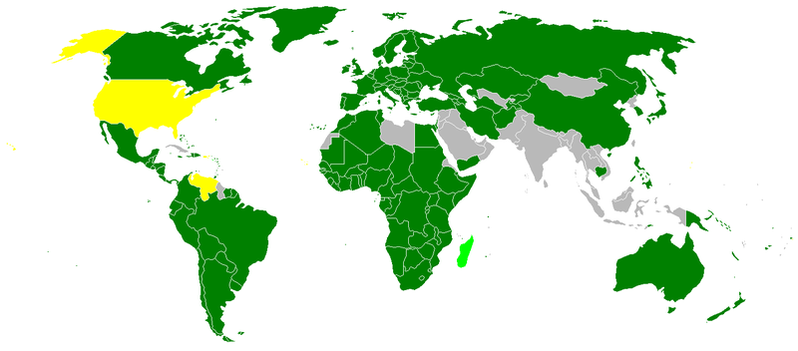
Refugee protection in the Asia-Pacific region

Slide 9
Protection issues in Asia-Pacific
Few countries are signatories to the Refugee Convention (only 4 out of 19 in South and South-East Asia)
Many refugees have no access to a refugee determination process (e.g. 1 million Burmese in Thailand, 200,000 Rohingya in Bangladesh)
Of those who do, many have no legal status in host country – treated as “illegal migrants” (e.g. in Malaysia, Bangkok)
No work rights – often face destitution or forced to work illegally, facing constant threat of arrest and detention.
Limited or no access to health care, education or social support.
After 10 years, Bali Process has resulted in no improvement in refugee protection – it sees people smuggling and trafficking as the core issues, not protection

Slide 10
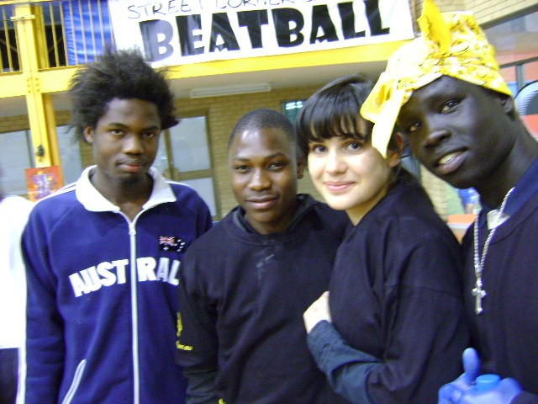
Australia’s role
Photo: Metropolitan Migrant Resource Centre WA

Slide 11
Australia in 2011 global stats
Asylum applications received – global total 1,669,725
Australia 15,441 (0.92%, 23rd overall, 32nd per capita)
Liberia 199,810; Kenya 178,340; Tunisia 154,505
(Includes individual asylum applications [860,654] and group recognition of refugees [809,071])
Asylum seekers recognised as refugees – 1,018,719
Australia 5,726 (0.56%, 24th overall, 29th per capita)
Liberia 199,250; Kenya 168,307; Tunisia 153,587
(Includes individual recognition [209,648] and group recognition of refugees [809,071])
Refugees resettled – 79,784
Australia 9,226 (11.56%, 3rd overall, 1st per capita)
United States 51,458; Canada 12,929; Sweden 1,895
(In 2011, one in 130 of refugees under UNHCR mandate and one in 190 of all refugees were resettled)
Refugees recognised and resettled – 1,098,503
Australia 14,952 (1.36%, 10th overall, 18th per capita)
Liberia 199,250; Kenya 168,307; Tunisia 153,587

Slide 12
Australia’s unique claims
785,235 refugees received from January 1901 to June 2012: 730,652 resettled, 54,583 through asylum process
Australia is:
The country which resettles more refugees per capita than any other.
The country with the world’s best post-arrival support for resettled refugees, according to UN High Commissioner for Refugees.
The only country which deducts resettlement places each time an asylum seeker is given refugee status.
The only OECD country and only Refugee Convention signatory to have mandatory detention for asylum seekers who arrive without visas.
About to become the first country in the world to excise its entire landmass from its own migration zone for people arriving by boat to seek asylum.

Slide 13
Complexity of Australia’s system
Australia puts refugees and asylum seekers into 6 categories:
Resettled refugees
Refugees referred by UNHCR – Refugee Program
Refugees proposed by permanent residents of Australia – Special Humanitarian Program
Asylum seekers
3. Asylum seekers who arrive by plane with a temporary visa – put on Bridging Visa (BV) while claim assessed
4. Asylum seekers who arrive by boat without a visa before 13 August 2012 – subject to mandatory detention, community detention and/or release on BV
5. Asylum seekers who arrive by boat without a visa after 13 August 2012 – subject to offshore processing or possible release on BV without work rights
6. Asylum seekers recognised as refugees but denied security clearance – indefinite detention, denied visa

Slide 14
Changes in past two years
Expansion of community detention (25 places in October 2010 to 1816 at 31 October 2012) for children, families and vulnerable asylum seekers
Swap deal with Malaysia proposed – and defeated in High Court
From November 2011, asylum seekers (boat arrivals) shifted from detention to Bridging Visas (7405 visas granted to 1 November 2012)
Average stay in detention cut from 277 days in November 2011 to 74 days in October 2012 but still 7633 in closed detention (including 797 children).
Introduction of complementary protection (March 2012)
End to separate legal regime for boat arrivals whose asylum claims assessed in Australia (March 2012). This policy was reversed in November 2012.

Slide 15
Formation of Expert Panel
Endless political criticism of increase in boat arrivals, from 25 people in 2007-08 to 8092 in 2011-12
More than 1000 deaths at sea off Australia in past 11 years, including more than 650 since 2009
Political impasse:
– Labor supports Malaysia arrangement but opposes Temporary Protection Visas (TPVs) and turning back boats
– Coalition supports offshore processing in Pacific, TPVs and turning back boats but opposes Malaysia arrangement
- Greens oppose all of the above and support onshore processing and building regional cooperation
92 deaths at sea on June 21. Labor legislation to enable Malaysia arrangement rejected by Parliament on June 28.
On June 28, Prime Minister formed Expert Panel – ex-head of Armed Forces, ex-head of Foreign Affairs, director of Victorian Foundation for Survivors of Torture – to research and come up with way forward within six weeks

Slide 16
Expert Panel recommendations
Mixture of deterrence and increased protection based on idea of ‘no advantage’ in boat journeys over ‘orderly migration’ to Australia.
Positive
Immediate increase in Australia’s Refugee and Humanitarian Program to 20,000 places, with focus on resettlement from Asia
Increased focus on protection through regional framework and bilateral cooperation with Indonesia and Malaysia
$70 million p.a. increase in funding for regional capacity building
Negative
Re-establishment of offshore processing arrangements on Nauru and Manus Island (PNG)
Extension of ‘excision’ policy to whole of Australia
Re-establishment of swap agreement with Malaysia
Excluding asylum seekers arriving by boat from family reunion under Special Humanitarian Program – but 4000 additional Family Migration places for refugee families
Continuation of anti-smuggling and disruption strategies and enhanced strategies for removals and returns

Slide 17
Policies of Liberal-National Coalition
What the Opposition parties are promising if elected in 2013:
Reverse the recent increase in Australia’s Refugee and Humanitarian Program
Continue offshore processing of applications for asylum seekers arriving by boat on Nauru and Manus Island
Push boats back to Indonesia in some cases
Presume against protection where asylum seekers have destroyed documents or have no documents
Immediate return of any asylum seeker from Sri Lanka.
Re-establish Temporary Protection Visa system
Create an ‘internal queue’ for permanent protection by limiting permanent visas to 2000 per year and deny permanent protection to anyone who arrived by boat
Focus resettlement almost exclusively on South East Asia but only on refugees from that region

Slide 18
Current refugee policy concerns
Domestic policy:
Monitoring detention conditions, limiting mandatory detention
Pushing for release of 54 recognised refugees (& 6 children) held in indefinite detention due to adverse security assessments
Ensuring full access to refugee status determination, legal advice, merits review and judicial review
Ensuring adequate support for asylum seekers on Bridging Visas, including right to work
Promoting the right to family reunion for refugees
Pushing for a statelessness status determination system
Offshore processing and regional cooperation:
Ensuring all protection-centred recommendations from Expert Panel are implemented
Monitoring conditions of transfer to Nauru and Manus Island and monitoring detention, return and resettlement arrangements
Advancing regional cooperation on protection
Opposing new offshore processing options

