Slide 1

Working together to build complete
homestay solutions.
7th December, Melbourne

Slide 2
David Bycroft – Executive Chairman
In 2006 a group of us with shared concerns established a strategy to bring acceptable guidelines and standards for both Homestay and short term/temporary accommodation for International Students
Little did we know that we were on a path which in 2012 would lead us to an innovative solution for the settling of Asylum Seekers into Australian way of life

Slide 3
Standards based Homestay
A management system for Homestay
National, State and Regional compliance standards
Online training for host families
Professional development for supervisors/providers
Network and structure
National branding, advertising and supply strategies
Insurance and emergency 24/7 phone support for guests and hosts

Slide 4
Community Placement of Asylum Seekers
During 2011 our Management Team commenced discussions with the Department of Immigration regarding the possibility that our success in the International Student industry could theoretically be duplicated for Asylum Seeker placements
We knew that this came with significant risk
In fact our internal Risk Management Workshop concluded that we should not do it
But….

Slide 5
Community Placement of Asylum Seekers
What was happening simply just wasn’t good enough
If we could find support from:
    Government
    Industry
    Media
    And Community
We had a good chance of making a difference.

Slide 6
Introducing:
The Community Placement Network (CPN)
www.homestaynetwork.org/cpn
Notes:
6

Slide 7


Slide 8
CPN Media Coverage
On May 3rd, 2012 we participated in over 40 media interviews in one day breaking our previous record of 2
Since May 3rd, there have been almost 200 individual positive media events with CPN incorporating television, radio and print

Slide 9
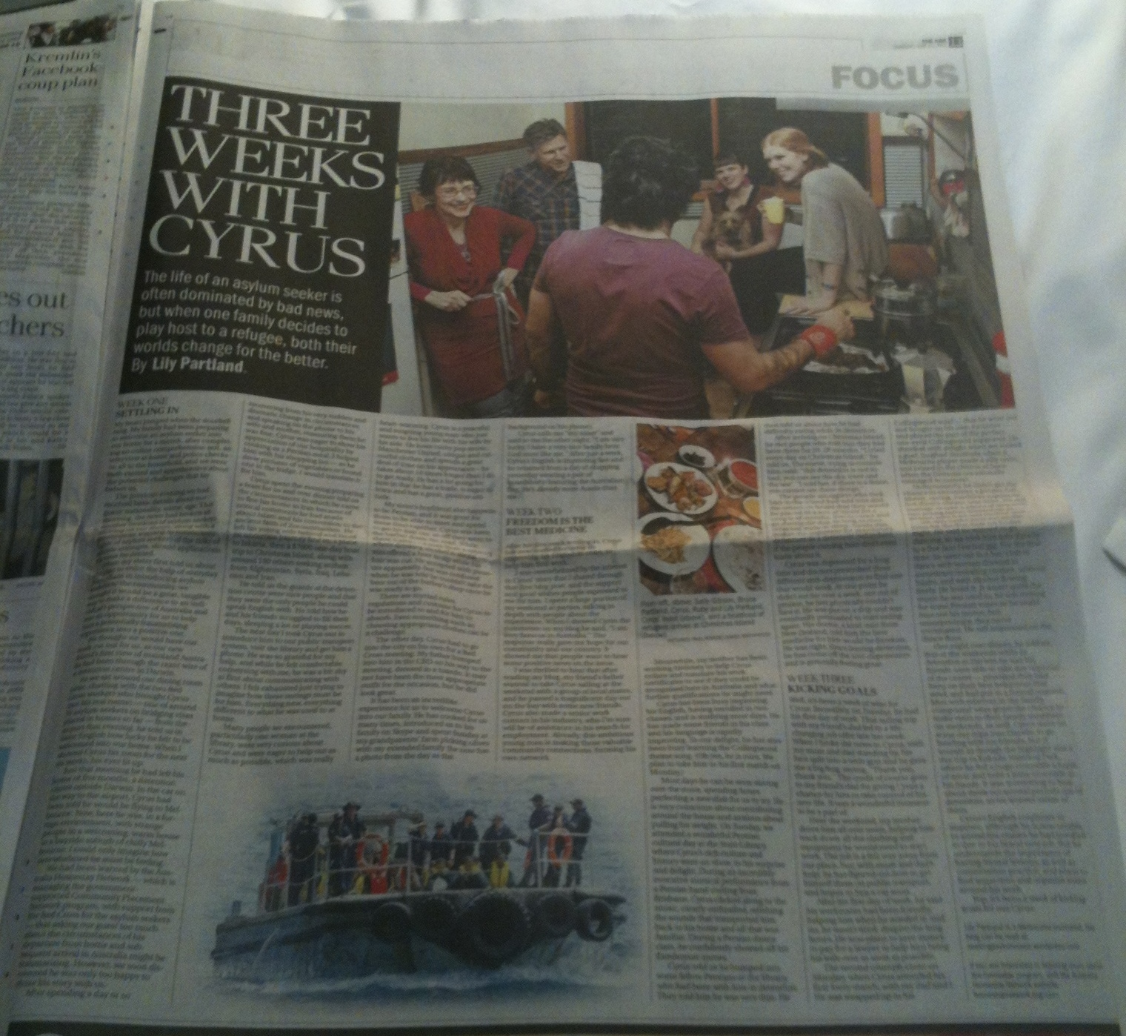
The Age
21st June 2012

Slide 10
The CPN Tsunami
Over the last 8 months we have linked with Refugee Council of Australia, Amnesty International, Red Cross (and other Government appointed providers) as well as numerous community organisations and groups
‘GetUp’ also supported the CPN Project
We have had Host applications from close to 4000 Australian Households which has so far converted into 600 successful ‘guest’ placements
We could do a lot more!

Slide 11
The Real Story
THE POWER OF ONE
BY HOSTS FROM AROUND AUSTRALIA

Slide 12
CPN Feedback from Australian Hosts
Perth:
“In his first week he shopped locally, cooked for himself, read
the paper, caught the train home from a City appointment,
dealt with a ticket Inspector, purchased a mobile phone and a camera, fixed the non-functioning mobile phone ,
washed his clothes, met neighbours, arranged his bank account and expressed sadness that he was not allowed to drive”

Slide 13
CPN Feedback from Australian Hosts
Brisbane:
“They are both becoming more independent and proactively
increasing their local knowledge every day
Home life is still fun, interactive and engaging
We are almost always practicing English in one way or another
They cook their own meals everyday (the best curries you have ever eaten!!), do their own laundry, and always clean up after themselves
I think we trust and respect each other and we have opened more than just our homes to these guys, we've opened our hearts and minds and this is an experience that we'll always remember
They are more than just our guests, they have become part of the family! ”

Slide 14
CPN Feedback from Australian Hosts
Perth:
“We are happy to say our first asylum seeker has found
accommodation and moved out last week
He has found a house sharing with others from his background but is still only minutes away from us so we can continue to support him
He also wants to get involved with the next one we get to make things easier for them also, so we are creating the beginnings of a network that will continue to grow as more come through the system”.

Slide 15
CPN Feedback from Australian Hosts
Adelaide
“This is the first time I have two guests from Afghanistan
….. I cannot express how it feels to have them here, both are male one of 27 and one of 19
I have NO restrictions in my home
Because of this, they genuinely feel as part of my family and they both help in the kitchen because they want to not because they have to”.

Slide 16
CPN Feedback from Australian Hosts
Brisbane:
“We just had a wonderful first weekend with our two guests
Already I think we have learned just as much from them as they have from us
We've enjoyed shared meal times, a trip to the market and lots of English practice
They are so polite and clean and show great respect for us and our home
It has already been an extremely rewarding, as we feel our lives are richer for having them with us
Their beautiful smiles have bought new light into our house,
and I think its safe to say we are all happy to share this
opportunity together :)”.

Slide 17
CPN Feedback from Australian Hosts
Adelaide:
“We take them shopping and involve them in our daily lives,
that is family
I have eaten Afghani food and they have eaten healthily and never complained once
I am so grateful that I have taken this opportunity to help but more than that, I have got to know another culture and seen and heard things that differ greatly from what you see in media
If you care you will win. Should anyone reading this want to contact me, I would be happy to help you.”

Slide 18
CPN Feedback from Australian Hosts
Ipswich
“Our Guest arrived two weeks ago, very little English, so a nervous beginning for us all, after being shown his room and facilities he freshened up after a long day and came out to our lounge room
The ice was soon broken as he saw our chess set and asked me to play, even though I wasn’t able to play chess, he taught me in one game, plenty of sign language & with lots of laughter, and fun
This has been an awesome experience for us all so far, I have never know anyone to be so committed to learning English, he studies his every waking moment.

Slide 19
CPN Feedback from Australian Hosts
I have helped by printing flash cards, and typing up sentence, but I have found the best knowledge of English is all around us, doing the shopping, going for drives, so we have lots of English lessons with our everyday lives
Now we have long conversations, and his sense of humour is wonderful as he laughs at our way of speaking, and we also laugh at his

Slide 20
CPN Feedback from Australian Hosts
We have taken him to the City to see the sights, to the theatre, and down to the Gold Coast to see the ocean, (although having seen it up close and personal on the boat he travelled on to get here) he had never seen its beauty until then
Up to the 24th floor to view the beach, and many other outings, visiting family and friends and he continues to say WOW!
He is so grateful, humble, and appreciative of all that we offer

Slide 21
CPN Feedback from Australian Hosts
He has come from Afghanistan, no phone, no TV, no shops, not much of anything
I have been so spoiled here in Australia my bubble has surely burst, it has been a real eye opener for me
I have listened to very sad stories, and cried many tears for him and his family, but I know he is safe now and he is looking forward to starting a new life here
Hopefully he can put all his past behind him and move forward, and his bad memories fade as time goes on.

Slide 22
CPN Feedback from Australian Hosts
He has now a job to go to in three to four weeks and a place to stay with his friend
I will surely miss him when he goes as he has had a big impact on our lives, I’m sure he feels the same way
We will stay in touch and I will look forward to one day meeting his wife and his three children, whom he hopes can come here to live with him
If your reading this and still having reservations about hosting, please don’t, you will be rewarded in so many ways
It has been the most rewarding experience I have ever had in my life ( and I'm getting on now so that’s big) and I’m sure there is more to come. Cheers”

Slide 23

The Media Run Continues
The media support and the successful outcomes we are getting have created increasing and ongoing interest
This month the Women's Weekly surprised us by publishing a 3 page story on one of their employees experiences as a CPN Host
Please buy a copy

Slide 24
Corporate Australia Joins In
We have generated a lot of interest from people from various Corporate sectors e.g.
A group of lawyers here in Melbourne wanted to help out
After discussions they have now established the:
The Community Placement Network Assistance Trust
David Kelly from Kelly Hazell Quill Lawyers, Melbourne
    An opportunity for Australians who cannot Host to donate money where 100% goes to frontline services
COMING SOON: The ‘CPN Helping Hand’ Program
    An opportunity to create a new low cost fully supported CPN Homestay Project where the ‘guest’ contributes as part of the household in exchange for reduced ‘rent and meals’

Slide 25
What YOU can do
Work with us – Coordination is the key!
Help Open Doors
Encourage Support from all levels of your community
Build Solutions
Help Knock Down Barriers
  of Bureaucracy
  Of Ignorance
Open up Regional Australia to CPN

Slide 26
QUESTIONS
Working together to build complete
homestay solutions.
7th December, Melbourne

