Slide 1
Refugee Protection Cooperation in the Asia Pacific
Dr Savitri Taylor, Associate Professor, Law School, La Trobe University
7 December 2012

Slide 2
Regional Perspective
Australia hosted 0.8%
of total at end 2011
La Trobe University

Slide 3
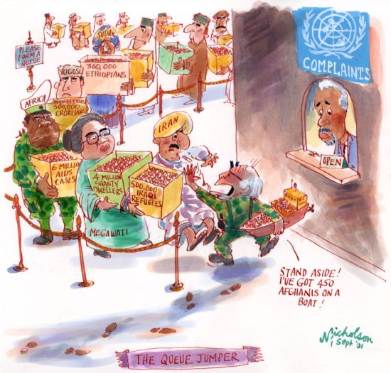
Coalition Government
La Trobe University

Slide 4
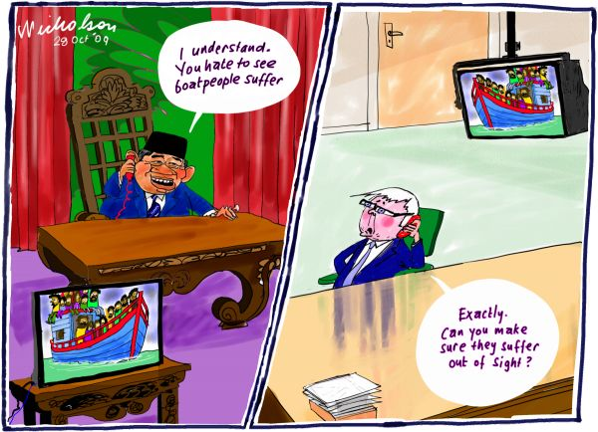

Labor Government
La Trobe University

Slide 5
Bali Process on People Smuggling, Trafficking in Persons and Related Transnational Crime
Inaugurated at a Ministerial level conference co-chaired by Australia and Indonesia in February 2002.
“Bali Process Countries”: All of the countries in East Asia and the Pacific, South Asia, South East Asia and South West Asia, plus Iraq, Jordan, Syria, Turkey and the United States of America.
Other key players: International Organization for Migration (IOM) and the Office of the United Nations High Commissioner for Refugees (UNHCR)
“Other Participating Countries and Agencies”:
18 other countries from outside the region, including several potential resettlement countries.
11 other intergovernmental organizations and processes with relevant mandates.
La Trobe University

Slide 6
Bali Process: Regional Cooperation Framework
Final Co-Chairs’ Statement, 30 March 2011
“16. Ministers agreed that an inclusive but non-binding regional cooperation framework would provide a more effective way for interested parties to cooperate to reduce irregular movement through the region. Ministers agreed to a regional cooperation framework underpinned by the following core principles:
i. Irregular movement facilitated by people smuggling syndicates should be eliminated and States should promote and support opportunities for orderly migration.
ii. Where appropriate and possible, asylum seekers should have access to consistent assessment processes, whether through a set of harmonised arrangements or through the possible establishment of regional assessment arrangements, which might include a centre or centres, taking into account any existing sub-regional arrangements.
iii. Persons found to be refugees under those assessment processes should be provided with a durable solution, including voluntary repatriation, resettlement within and outside the region and, where appropriate, possible “in country” solutions.
iv. Persons found not to be in need of protection should be returned, preferably on a voluntary basis, to their countries of origin, in safety and dignity. Returns should be sustainable and States should look to maximise opportunities for greater cooperation.
v. People smuggling enterprises should be targeted through border security arrangements, law enforcement activities and disincentives for human trafficking and smuggling.”
La Trobe University

Slide 7
Bali Process: Regional Cooperation Framework
Final Co-Chairs’ Statement, 30 March 2011
“19. Ministers agreed that in developing and implementing practical arrangements participating States should be guided by the following considerations:
    (i) Arrangements should promote human life and dignity.
    (ii) Arrangements should seek to build capacity in the region to process mixed flows and where appropriate utilise available resources, such as those provided by international organisations.
    (iii) Arrangements should reflect the principles of burden-sharing and collective responsibility, while respecting sovereignty and the national security of concerned States.
    (iv) Arrangements should seek to address root causes of irregular movement and promote population stabilisation wherever possible.
    (v) Arrangements should promote orderly, legal migration and provide appropriate opportunities for regular migration.
    (vi) Any arrangements should avoid creating pull factors to, or within, the region.
    (vii) Arrangements should seek to undermine the people smuggling model and create disincentives for irregular movement and may include, in appropriate circumstances, transfer and readmission.
    (viii) Arrangements should support and promote increased information exchange, while respecting confidentiality and upholding the privacy of affected persons.”
La Trobe University

Slide 8
Bali Process: Regional Support Office
Foundation Projects
Enhancing Collection, Use and Sharing of Data (12 month project)
    Proposed & funded by Australian Department of Immigration (DIAC)
    Implemented by IOM
Voluntary Return Support and Reintegration Assistance (12 month pilot project)
    Proposed & funded by DIAC
    Implemented by IOM (with UNHCR and Bali Process countries).
Regional Roundtable on Irregular Movements by Sea (by end 2012)
    Proposed & to be implemented by UNHCR
    Funded by United States
Pilot study on information exchange and data analysis on irregular migration by sea (still being scoped).
    Proposed by UNHCR
    Additional Project: Mapping and Analyzing the Protection Situation of Unaccompanied and Separated Children in South East Asia (6 month project)
      Proposed by UNHCR
      Implementation contracted out by UNHCR to a team of academics led by Dr Sriprapha Petcharamesree of Mahidol University in Thailand
      Funded by DIAC
La Trobe University

Slide 9
Bali Process: Bilateral and Multilateral Arrangements
Arrangement between the Government of Australia and the Government of Malaysia on Transfer and Resettlement, 25 July 2011
Not legally binding
Australia able to transfer up to 800 irregular maritime arrivals (IMAs) to Malaysia
In return (and regardless of how many IMAs were transferred), Australia undertook to resettle 4000 recognised refugees then residing in Malaysia over the next 4 years
Transferees to be given opportunity to have asylum claims considered by UNHCR and to have access to resettlement if found to be refugees.
However, transferees to be given no advantage over other asylum seekers and refugees in Malaysia.
Transfer frustrated by Plaintiff M70/2011 v Minister for Immigration and Citizenship [2011] HCA 32 (31 August 2011)
La Trobe University

Slide 10
The Houston Report
Houston Report Recommendation 7
“The Panel recommends that legislation to support the transfer of people to regional processing arrangements be introduced into the Australian Parliament as a matter of urgency (paragraphs 3.54 and 3.57). This legislation should require that any future designation of a country as an appropriate place for processing be achieved through a further legislative instrument that would provide the opportunity for the Australian Parliament to allow or disallow the instrument (paragraph 3.43).”
Implemented by Migration Legislation Amendment (Regional Processing and Other Measures) Act 2012 (entered into force on 18 August 2012)
La Trobe University

Slide 11
The Houston Report
Houston Report Recommendation 10
“The Panel recommends that the 2011 Arrangement between the Government of Australia and the Government of Malaysia on Transfer and Resettlement (Malaysia
Agreement) be built on further, rather than being discarded or neglected, and that this be achieved through high-level bilateral engagement focused on strengthening
safeguards and accountability as a positive basis for the Australian Parliament’s reconsideration of new legislation that would be necessary (paragraphs 3.58-3.70).”
Greens and Coalition unlikely to allow designation of Malaysia as a regional processing country.
La Trobe University

Slide 12
The Houston Report
Houston Report Recommendation 8
“The Panel recommends that a capacity be established in Nauru as soon as practical to process the claims of IMAs transferred from Australia in ways consistent with Australian and Nauruan responsibilities under international law (paragraphs 3.44-3.55).”
Houston Report Recommendation 9
“The Panel recommends that a capacity be established in PNG as soon as possible to process the claims of IMAs transferred from Australia in ways consistent with the responsibilities of Australia and PNG under international law (paragraphs 3.56-3.57).”
La Trobe University

Slide 13
Pacific Solution Mark II
Memorandum of Understanding between the Republic of Nauru and the Commonwealth of Australia, Relating to the Transfer to and Assessment of Persons in Nauru, and Related Issues, signed 29 August 2012
Nauru designated as a regional processing country on 10 September 2012.
Memorandum of Understanding between the Government of the Independent State of Papua New Guinea and the Government of Australia, Relating to the Transfer to and Assessment of Persons in Papua New Guinea, and Related Issues, signed 8 September 2012
PNG designated as a regional processing country on 9 October 2012.
La Trobe University

Slide 14
Pacific Solution Mark II
Treatment consistent with human rights standards (including appropriate accommodation and no arbitrary detention)?
NO
Protection from refoulement?
NO
Implementation of “no advantage” principle compatible with adherence to Australia’s international legal obligations?
NO
La Trobe University

Slide 15
The Houston Report: The Good Bits
Houston Report Recommendation 2
“The Panel recommends that Australia’s Humanitarian Program be increased
and refocused:
The Humanitarian Program be immediately increased to 20,000 places per annum (paragraphs 3.3-3.8).
Of the 20,000 places recommended for the Humanitarian Program, a minimum of 12,000 places should be allocated for the refugee component which would double the current allocation (paragraphs 3.3-3.8).
Subject to prevailing economic circumstances, the impact of the Program increase (recommended above) and progress in achieving more effective regional cooperation arrangements, consideration be given to increasing the number of places in the Humanitarian Program to around 27,000 within five years (paragraphs 3.3-3.8).
The Humanitarian Program be more focused on asylum-seeker flows moving from source countries into South-East Asia (paragraphs 3.3-3.9).”
La Trobe University

Slide 16
The Houston Report: The Good Bits
Houston Report Recommendation 3
“The Panel recommends that in support of the further development of a regional cooperation framework on protection and asylum systems, the Australian Government expand its relevant capacity-building initiatives in the region and significantly increase the allocation of resources for this purpose (paragraphs 3.26-3.28).”
Houston Report Recommendation 6
“The Panel recommends a more effective whole-of-government strategy be developed for engaging with source countries for asylum seekers to Australia, with a focus on a significant increase in resettlement places provided by Australia to the Middle East and Asia regions (paragraphs 3.29-3.33).”
Houston Report Recommendation 13
“The Panel recommends that Australia promote more actively coordinated strategies among traditional and emerging resettlement countries to create more opportunities for resettlement as a part of new regional cooperation arrangements (paragraphs 3.35-3.37).”
La Trobe University

Slide 17
The Coalition Position
Scott Morrison, Address to the Lowy Institute, 7 August 2012
“The Coalition believes that Labor’s focus on processing and resettlement over deterrence and border security will create a regional asylum magnet that will only further encourage secondary movement and undermine the integrity of existing regional resettlement programs, of which Australia is the primary participant.
That is why a Coalition Government will restore Australia’s focus in the Bali Process on deterrence policies, which remain the overwhelming focus of other participant countries, and in particular our co-chair Indonesia.”
La Trobe University

Slide 18
Leading by Example
Statement of Reasons for Thinking that It Is in the National Interest to Designate Nauru [PNG] to be a Regional Processing Country
“36. However, even if the designation of Nauru [PNG] to be a regional processing country is inconsistent with Australia's international obligations, I nevertheless think that it is in the national interest to designate Nauru [PNG] to be a regional processing country”.
La Trobe University

Slide 19
Leading by Example
Asia Pacific Refugee Rights Network
Began in November 2008
Has membership of 116 organisations and individuals across the region
      Deputy Chair: Tamara Domicelj, ACT for Peace, Australia
Geographical Working Groups
South Asia
South East Asia
East Asia
    Australia, New Zealand and the Pacific (Deputy Chair: Paul Power, RCOA)
Thematic Working Groups
      Immigration Detention (Chair: Grant Mitchell, Immigration Detention Coalition)
      Legal Aid And Advocacy
Right to Health
Women and Girls at Risk (Chair: Efterpy Mitchell, Centre for Refugee Research, UNSW)
Statelessness
La Trobe University

Slide 20
Useful References
Amnesty International Australia, Media Release and Nauru Brief, 23 November 2012, http://www.amnesty.org.au/images/uploads/news/NauruOffshoreProcessingFacilityReview2012.pdf
Asia Pacific Refugee Rights Network web site http://www.aprrn.info
Bali Process web site http://www.baliprocess.net/
Bali Process Regional Processing Office web site http://www.baliprocess.net/regional-support-office
DIAC, Departmental guidelines for assessment of persons prior to Transfer pursuant to section 198AD(2) of the Migration Act 1958 www.immi.gov.au/visas/humanitarian/_pdf/s198ad-2-guidelines.pdf
Expert Panel on Asylum Seekers web site http://expertpanelonasylumseekers.dpmc.gov.au/
Memorandum of Understanding relating to the Transfer to and Assessment of Persons in Nauru, and Related Issues, 29 August 2012, http://www.minister.immi.gov.au/media/media-releases/_pdf/australia-nauru-mou-regional-processing.pdf
Memorandum of Understanding relating to the Transfer to and Assessment of Persons in Papua New Guinea, and Related Issues, 8 September 2012 http://www.minister.immi.gov.au/media/media-releases/_pdf/mou-between-png-australia-regional-processing.pdf
Migration Act 1958 (Cth) as amended http://www.austlii.edu.au/au/legis/cth/consol_act/ma1958118/
Migration Regulations 1994 (Cth) as amended http://www.austlii.edu.au/au/legis/cth/consol_reg/mr1994227/
La Trobe University

Slide 21
Useful References
Minister for Immigration, “Nauru designated for regional processing”, Press Release, 10 September 2012, http://www.minister.immi.gov.au/media/cb/2012/cb189739.htm (includes link to designation and statement of reasons)
Minister for Immigration, “Papua New Guinea designated for regional processing”, Press Release, 9 October 2012, http://www.minister.immi.gov.au/media/cb/2012/cb190599.htm (includes link to instrument of designation and statement of reasons)
Nicholson Cartoons http://nicholsoncartoons.com.au/reproduce-a-cartoon
Minister for Immigration, Minister’s determination power under section 198AE of the Migration Act 1958 to determine that section 198AD does not apply www.immi.gov.au/visas/humanitarian/_pdf/s198ae-guidelines.pdf
Refugee Convention Act 2012 (Nauru) http://ronlaw.gov.nr/nauru_lpms/files/acts/54646b11f70f570114c42651ac6cc548.pdf
UNHCR, 2011 Global Trends, Annex http://www.unhcr.org/globaltrends/2011-GlobalTrends-annex-tables.zip
United Nations High Commissioner for Refugees, Letter to Chris Bowen re proposed designation of Nauru, 5 September 2012, http://unhcr.org.au/unhcr/images/120905%20response%20to%20minister%20bowen.pdf
United Nations High Commissioner for Refugees, Letter to Chris Bowen re proposed designation of PNG, 9 October 2012, http://unhcr.org.au/unhcr/images/121009%20response%20to%20minister%20on%20png.pdf
La Trobe University

