Slide 1
Evaluating the Contribution of Refugee Settlers in Australia
by
Graeme Hugo
ARC Australian Professorial Fellow
Professor of Geography and Director of the Australian Population and Migration Research Centre
The University of Adelaide
Presentation to Third National Conference on the Pastoral Care of Migrants and Refugees, Australian Catholic Bishops Conference, St Patrick’s Campus, Australian Catholic University, Melbourne
7th December 2012

Slide 2
Outline of Presentation
Introduction
Post Flight Contexts
Third Country Settlement
Australia Refugee Migration
Demographic Contribution
Economic Contribution
Social and Civic Contributions
Conclusion

Slide 3
Context
Project initiated by DIAC and Minister for Immigration.
Opposition by Treasury to expansion of refugee intake.
Each year 800,000 new refugees, 80,000 accepted for resettlement.
Increasing “donor fatigue” in accepting refugees.

Slide 4
Lasting Solutions for Forced Migrants
Permanent Settlement in Temporary Refuge/Asylum Country
Permanent Settlement in a Third Country
Voluntary Return, Refoulement

Slide 5
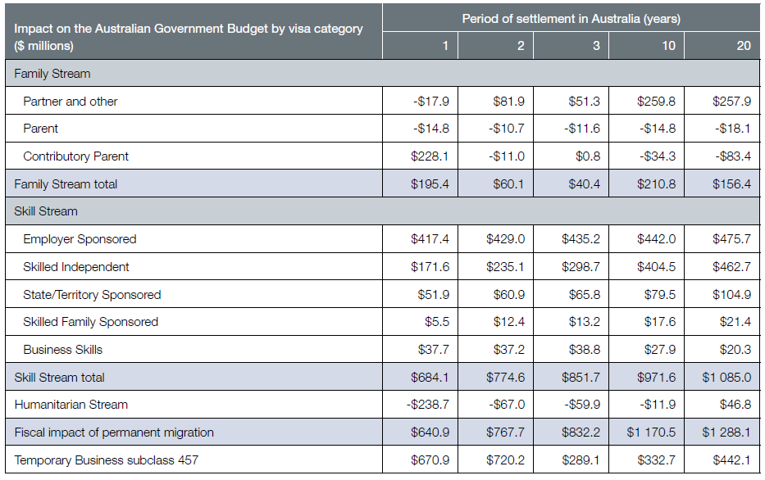
Migrants’ net impact on the Australian Government Budget by visa category ($ million 2009–10)
Source: DIAC 2011

Slide 6
Challenges of Settlement
By definition refugees are at a disadvantage compared to other immigrants
- No preparation for the move
- Unable to bring their resources with them
- Disruption of upheaval
- Splitting up of family during movement
- Lack of family networks at destination
- Recognition of qualifications, loss of documentation
- extended period in camps
- more prone to stereotyping and

Slide 7
Australia as a Refugee Destination
More than 700,000 settled since World War II
Important and continuing part of Australian economy and society
Prime motivation humanitarian
In discourse focus has been on costs, little on benefits

Slide 8
Australia: Humanitarian Program Permanent Additions, 1976 to 2011
Source: DIAC unpublished data, Australian Immigration: Consolidated Statistics and Immigration Update, various issues

Slide 9
Australia: Unauthorised Arrivals, 1989-90 to 2011-12
Source: DIMIA 2002, 2004 and 2005; DIAC 2007; DIAC Annual Report, various issues; Phillips and Spinks 2012

Slide 10
Australia: Net Overseas Migration, Settler Arrivals, Asylum Applications Lodged and Humanitarian Program Permanent Additions, 2005-6 to 2010-11
Source: ABS 2011, DIAC 2010 and 2011a and b

Slide 11
Refugee and Humanitarian Arrivals 1977-78 to 2001-02 and Permanent Additions 2002-03 to 2010-11 to Australia by Region of Birth
Source: DIMIA Australian Immigration Consolidated Statistics and DIAC Immigration Update, various issues

Slide 12
Data Issues
Conceptual Issue when does a refugee cease to be a refugee and become a settler?
Limits of standard stock and flow data sets to recognise refugees, especially stock data
Major barriers to analysing the settlement experience
Lack of adequate sampling frames for representative survey work

Slide 13
Analysis of Census Data
Problem of no identification of visa category among overseas-born in census and most other data collections
Concept of “Refugee-Humanitarian Birthplace Groups”
Index of Dissimilarity between Humanitarian and all other parts of migration program for birthplace groups is 74.8
ID with Skilled Migrants only is 91.0
ABS/DIAC Linked Data Set 2006/2011 Censuses

Slide 14
Assessment of Impact
The Treasury’s Intergenerational Report argues Australia’s future prosperity in the face of an ageing population will be a function of the three Ps – population, participation and productivity
Also examine social and civic engagement

Slide 15
Demographic Impact
Since 1978 – over 450,000 refugee-humanitarian settlers
More than 1 million in Refugee-Settler Humanitarian 1st and 2nd generation at 2006 census

Slide 16
Key Features of Demography
Younger than other migrant groups, high proportion of children – demographic dividend
Fertility – slightly higher on average
Low levels of settler loss
Increasing numbers in regional communities

Slide 17
Australia: Settlement of Refugee-Humanitarian Settlers Outside Capital Cities, 1996 to 2011
Source: DIAC

Slide 18
The Economic Contribution
Workforce Participation
Other Economic Contributions

Slide 19
‘Humanitarian migrants entering as part of the second cohort were surprisingly much less likely to have entered the Australian labour market 18 months after migration’ (compared to LSIA 1). ‘Although the probability of being unemployed – conditional on labour market entry – is also substantially lower, the fall in participation dominates’.
(Cobb-Clark, 2006, 50)

Slide 20
Why is this Stereotype Only Part of the Story?
Need for care in interpretation of LSIA
Need for a longer time frame in considering impact and contribution
Need for a wider perspective of contribution beyond labour force participation

Slide 21
Key Issues in Assessing Workforce Participation of Refugee-Humanitarian Settlers
Time
Length of Residence in Australia
Intergenerational differences
Most sources concentrate on initial years
Need to examine stock of first and second generation settlers

Slide 22
Labour Force Experience
Undoubtedly higher unemployment and lower labour force participation than other migrants in early years
Function of language, education, circumstances of migration, less family support, health and recognition of qualifications, deskilling, discrimination
Need for longer time perspective

Slide 23
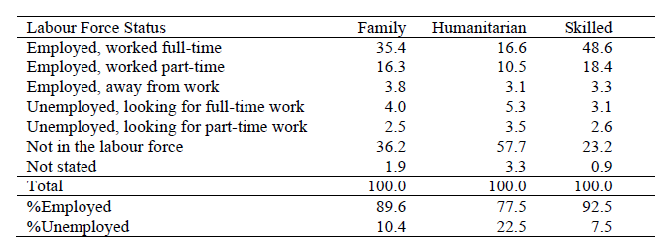
Labour Force Issues
Visa Type of Arrivals 2001-06 by Labour Force Status in 2006: Proportion (Percent) of All Migrants Aged Over 15 Years
Source: ABS/DIAC Data Linkage Project

Slide 24
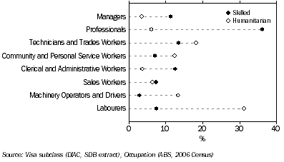
Occupation of Employed Migrants, 15 Years and Over, 2006
Source: ABS, 2010b, 13-14

Slide 25
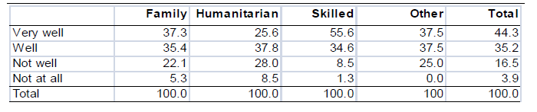
Visa Type of Settler Arrivals, 2001-06 by English Proficiency in 2006: Proportion (%) of All Migrants Aged Over 15 Years
Source: ABS/DIAC Data Linkage Project

Slide 26
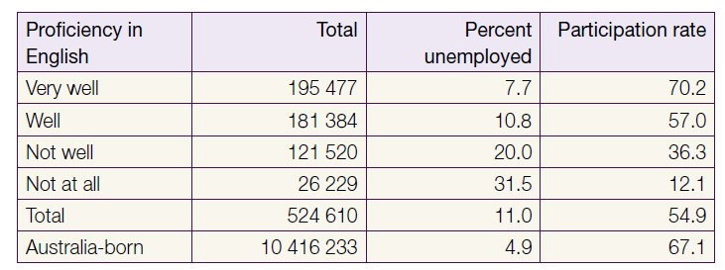
First Generation Humanitarian Entrants: Proficiency in Spoken English by Labour Force Status, 2006
Source: DIAC 2011, p.24

Slide 27
Joint Standing Committee on Migration (2006) emphasised humanitarian migrants face some skills recognition difficulties not faced by other migrants. Hence their contribution toward productivity is less than it could be

Slide 28
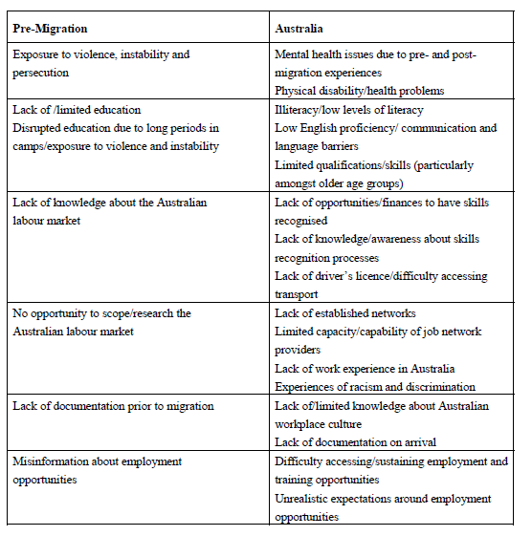
Barriers to Employment for Refugees as Identified by Key Informants
Source: Hugo et al, 2011

Slide 29
Negative Workforce Experiences
“Occupational Skidding” where refugee-humanitarian settlers don’t get jobs commensurate with their skills
Occupational segmentation where refugee-humanitarian settlers get stuck in low status occupations
The Refugee Gap
Group most affected by Global Financial Crisis

Slide 30
There is substantial evidence of a “brain waste” among refugee-humanitarian settlers where they do not get jobs commensurate with their skill/education. There is evidence of
- discrimination on the basis of race, religion and ethnic origin
- structural disadvantage in the workplace

Slide 31
Australia: First AND Second Generation REFUGEE-Humanitarian Birthplace Groups, Australia-BORN and Overseas-Born PECENT IN LABOURER AND MACHINERY OPERATOR OccupationS BY POST-SCHOOL Education, 2006
Source: ABS 2006 Census unpublished tabulations

Slide 32
Australia: First and Second Generation Refugee-Humanitarian Birthplace Groups, Australia-Born and Overseas-Born Percent In Managerial And Professional Occupations by Post-School Education, 2006
Source: ABS 2006 Census unpublished tabulations

Slide 33
Australia: Unemployment Rate of the Overseas-Born by Region of Birth, April 2001 to March 2010
Source: ABS Australian Labour Force Surveys

Slide 34
The Contribution of Refugee Humanitarian Settlers
Much of discourse is on “costs”, very little on benefits
Much based on first couple of years of settlement
Need for focus over longer period of settlement – even intergenerational

Slide 35
Examination of Contribution
The Treasury’s Intergenerational Report argues Australia’s future prosperity in the face of an ageing population will be a function of the three Ps – population, participation and productivity
Also examine social and civic engagement

Slide 36
Population
Since 1978 – over 450,000 refugee-humanitarian settlers
More than 1 million in Refugee-Settler Humanitarian 1st and 2nd generation at 2006 census

Slide 37
Key Features of Demography
Younger than other migrant groups, high proportion of children – demographic dividend
Fertility – slightly higher on average
Low levels of settler loss
Increasing numbers in regional communities

Slide 38
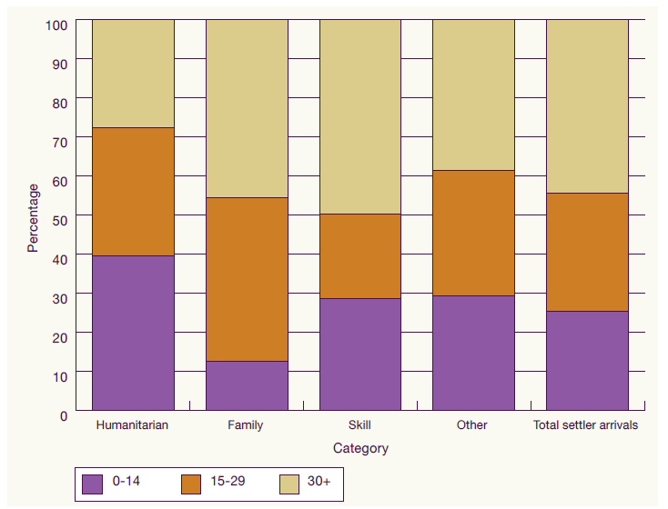
Settler Arrivals by Migration Category, 2003-04 to 2008-09
Source: DIAC 2011, p.15

Slide 39
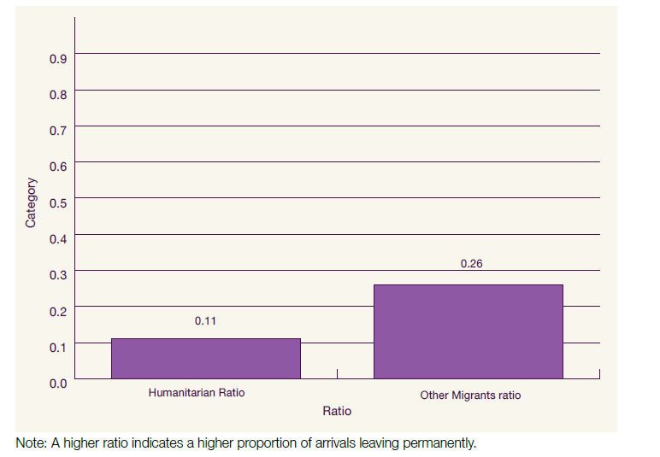
Humanitarian Arrivals by Humanitarian Wave and Permanent Departures, 1991-92 to 2008-09
Source: DIAC 2011, p.17

Slide 40
Australia: Settlement of Refugee-Humanitarian Settlers in Regional Areas, 1996 to 2010
Source: DIAC

Slide 41
Participation
Varies between different birthplace groups
Increases with length of time in Australia
Converges toward Australia-born
Second generation have higher participation levels than Australia-born

Slide 42
The proportion of recent refugee arrivals aged between 15 and 24 who are attending an educational institution is higher than the rate of other arrivals

Slide 43
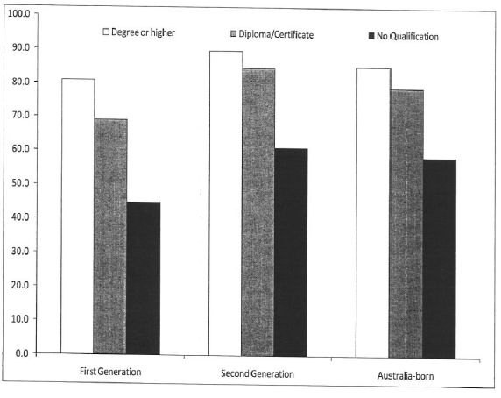
The Refugee Gap
Australia: Participation Rate by First, Second Generation and Australia-Born and Qualifications, 2006
Source: ABS, 2006 Census

Slide 44
Intergenerational Perspectives: Percent in Professional Occupations

Slide 45
Productivity: A Mixed Experience
Clear evidence of upward mobility
However also some groups trapped in low income jobs
The “refugee gap”
Need for removal of discrimination, facilitate recognition of qualifications and experience to “level playing field”
However filling important shortages in labour market not filled by other migrant groups

Slide 46
Other Economic Contributions
To what extent are humanitarian settlers setting up new businesses which contribute to enhanced employment and productivity?
To what extent are humanitarian settlers filling particular niches in the Australian labour market?
To what extent are humanitarian settlers developing economic linkages with their countries of origin?

Slide 47
Distinctive Contribution
Fill lower skilled jobs eschewed by Australians
One of the few areas in migration program to provide low skilled workers
Labour shortages are not only in high skill areas

Slide 48
The Unmeasurables of Migration Selectivity
People who move tend to be selected from risk takers
Migrants tend to be more entrepreneurial, business start ups
Does the points system select such people?
Increasing evidence that refugee-humanitarian groups contain a disproportionate representation of entrepreneurial people

Slide 49
2006 Census : Percent Owner-Manager

Slide 50
Evidence of High Level of Entrepreneurialism
Historical – DPs
Vietnamese – study of boatload of arrivals from late 1970s
Case Studies
BRW 2000 – 5 of 8 billionaires of refugee background
2010 – 3 of top 10 earners

Slide 51
Linkages with Homelands and Other Diaspora
Areas of Contribution (RCOA 2010)
Development impacts in origin – “development dividend”
Remittances
Fostering trade linkages
Planning and targeting foreign development assistance

Slide 52
Australia: Outflows of Remittances in US$ Millions, 1970-2010
Source: World Bank Remittances Database

Slide 53
Limited Evidence on Remittances
Remit more than other migrant groups
70% of survey respondents sent remittances
Other studies of African groups had similar findings
Evidence of funding particular initiatives in homeland

Slide 54
Fostering Trade
Increasing body of research showing positive relationship between trade and immigration
Immigrants from low income countries with difference cultural background create more than other groups
Case studes

Slide 55
The Social and Civic Contribution
‘social capital provided by refugees represents a significant portion of their contribution to Australia … The social capital and connections that refugees bring to the community are powerful.’
Refugee Council of Australia (RCOA) (2010, 54)

Slide 56
Volunteering
Limited data
However increasing evidence of both formal and informal volunteering
Wider community as well as within ethnic communities

Slide 57
Volunteering
Underestimated volunteering within ethnic groups
Importance of informal volunteering
Crucial significance of social capital
Important tool for integrating refugees into economy and society

Slide 58
Connections
One quarter had no family or friends in Australia on arrival
Strong attachment to local communities
Case studies
Role of community leaders
Greater civic engagement by second generation

Slide 59
Australian Humanitarian Settler Survey: Assistance Given to Others in Their Ethnic Community
Source: Australian Humanitarian Settler Survey 2010

Slide 60
Degree of Connection to Local Community Among Recent Arrivals by Visa Category, 2009
Source: SONA Study

Slide 61
Australian Humanitarian Settler Survey: Description of Local Neighbourhood Social Networks
Source: Australian Humanitarian Settler Survey 2010

Slide 62
Australian Humanitarian Settler Survey: Do You Feel a Part of Your Local Neighbourhood?
Source: Australian Humanitarian Settler Survey 2010

Slide 63
Australian Humanitarian Settler Survey: Answers to Question ‘I am Happy With My Life in Australia’
Source: Australian Humanitarian Settler Survey 2010

Slide 64
Conclusion
The primary justification for refugee programs in destination must always be humanitarian and relate to nation states role as an international citizen
However there needs to be full recognition that refugee settlers make a particular and significant economic contribution
In medium and longer term refugee-humanitarian migrants are a net economic gain to Australia
Stereotypes and stigmatisation of refugee-humanitarian settlers are not justified by the empirical evidence
Policy implications

