Slide 1


Catholics and Muslims Building Bridges
Rev Dr Patrick McInerney

Slide 2
Outline
Introduction
  Commonalities and Differences
1. Salient Facts
  Islam in Australia
  Country of Origin
  “Fit in or …. “
2. Practices & Beliefs on which to Build Bridges
  The Pillars of Islam
  The Beliefs of Islam
  Morals/Ethics
3. Three Reasons for Dialogue
  Statistics/World Peace
  The 8th Commandment
  Church Teaching
Conclusion

Slide 3
Commonalities and Differences
We celebrate both our commonalities and differences, because if we had nothing in common we could not communicate, and if we had everything in common, we would have nothing to say.
Rabbi Jonathan Sacks, 2010

Slide 4
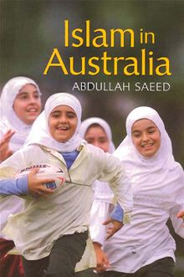
Islam in Australia
No such thing!!!
Differences
  National
  Ethnic
  Cultural
  Social
  Educational
  Linguistic
  Religious Observance
  Law
Islams in Australia

Slide 5
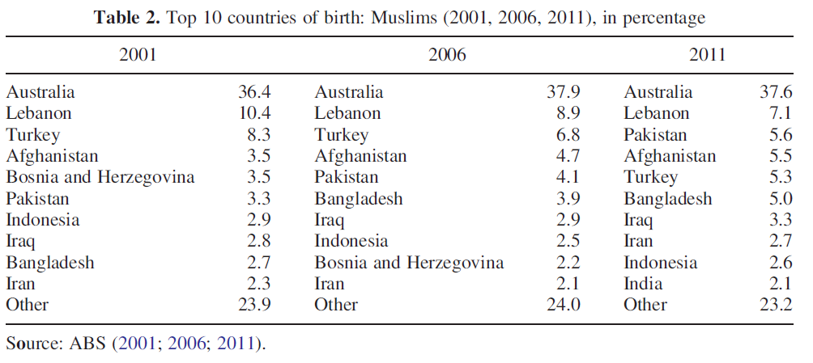
Country of Origin

Slide 6

****

Slide 7
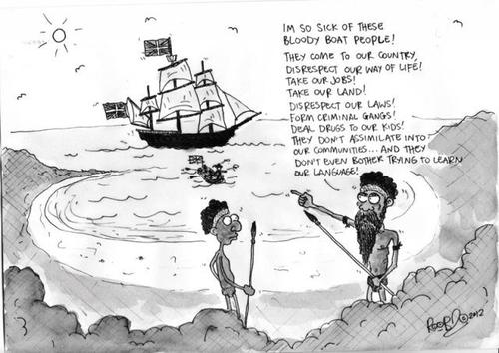

Slide 8
FIVE PILLARS OF ISLAM
Testimony of Faith Shahādat
Worship (Prayer) Salāt
Fasting during Ramadān Sawm
Alms-Tax Zakāt
Pilgrimage Hajj

Slide 9
BELIEFS OF ISLAM
Belief in God
  Arabic word is Allah
Belief in Angels
  Gabriel …
Belief in Prophets
  Adam, Abraham, Moses, David, Jesus, …. Muhammad
Belief in Books/Scriptures
  Torah through Moses
  Psalms through David
  Gospel (injīl) through Jesus
  Holy Qur’an through Muhammad
Belief in Last Day/Judgement
  Heaven
  Hell
Belief in Destiny
  Providence

Slide 10
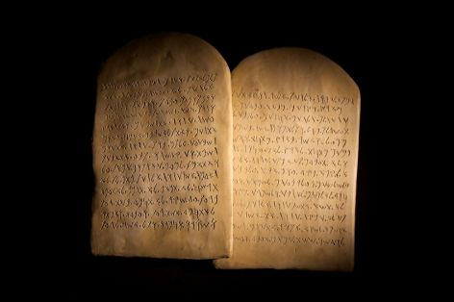
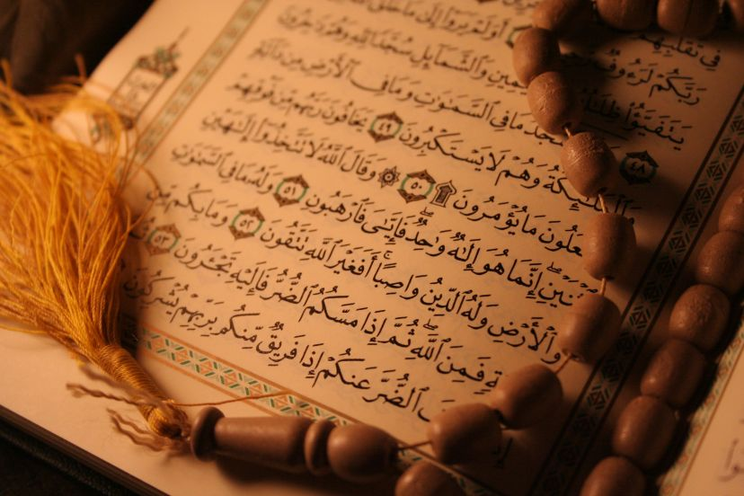
Moral/Ethics
The Ten Commandments
The Qur’an, Sunnah & Shari’a

Slide 11
The Golden Rule
In everything, do to others what you would have them do to you; for this is the law and the prophets. (Mt 7:12, also Lk 6:31)
Tweet others as you want them to tweet you!!
  لا يؤمن أحدكم حتى يحب لأخيه ما يحب لنفسه
  None of you has faith until he loves for his brother what he loves for himself.
    Sahih Bukhari 13; Sahih Muslim 45

Slide 12
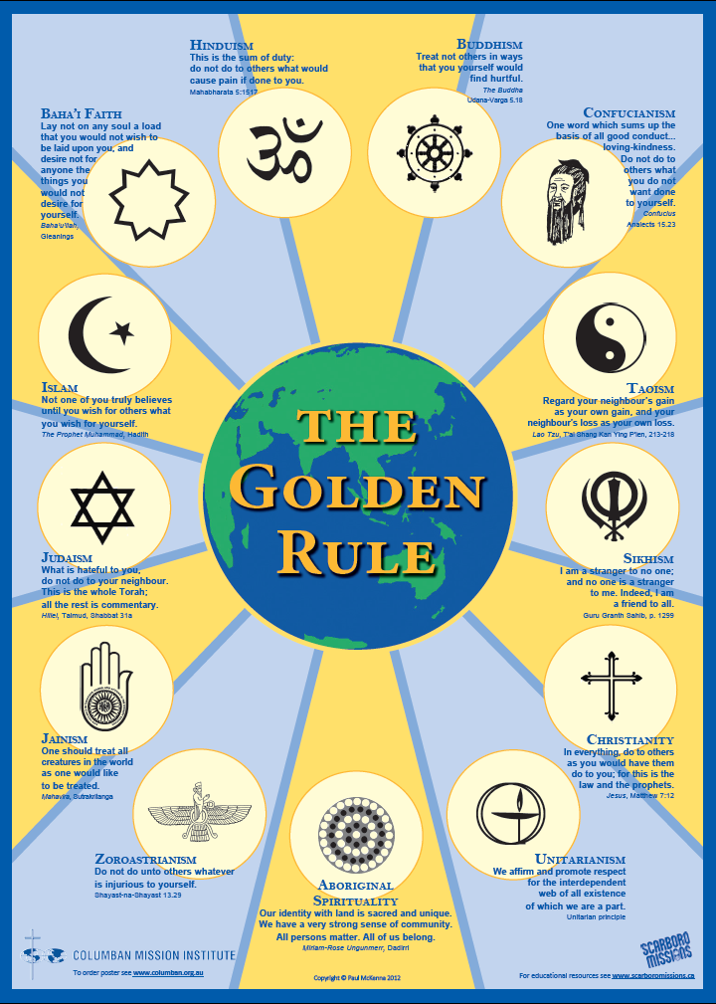

Slide 13
Reasons for Dialogue - 1
Statistics/World Peace
  Inter-religious dialogue and inter-cultural dialogue between Christians and Muslims cannot be reduced to an optional extra. It is in fact, a vital necessity, on which in large measure our future depends.
    Benedict XVI, Cologne, 2005
    (See also “A Common Word”)

Slide 14
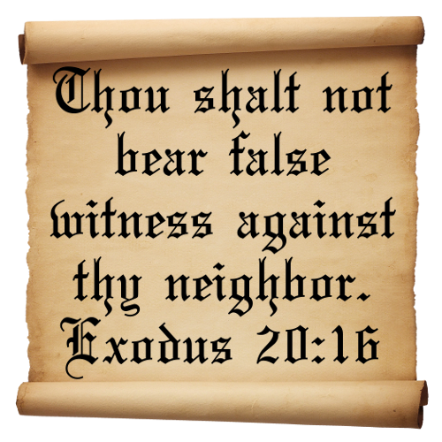
Reasons for Dialogue - 2
The 8th Commandment
“Thou shalt not bear false witness against thy neighbor.”
Ex 20:16;
cf. Deut 5:20

Slide 15
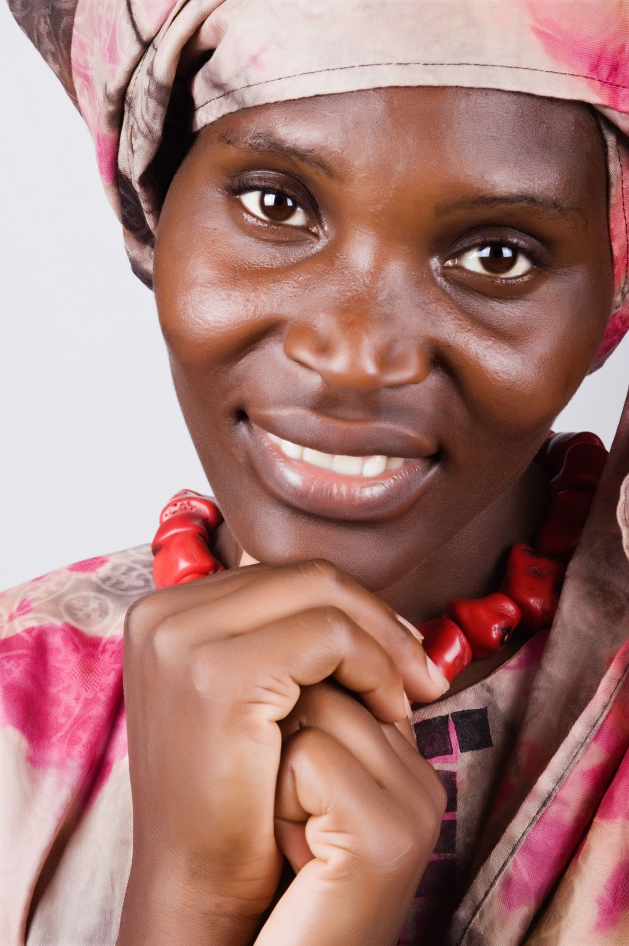
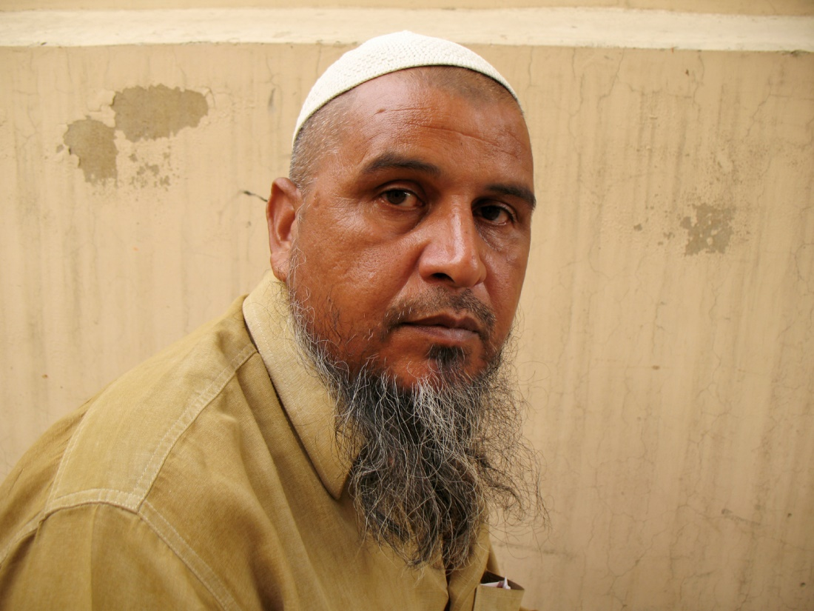
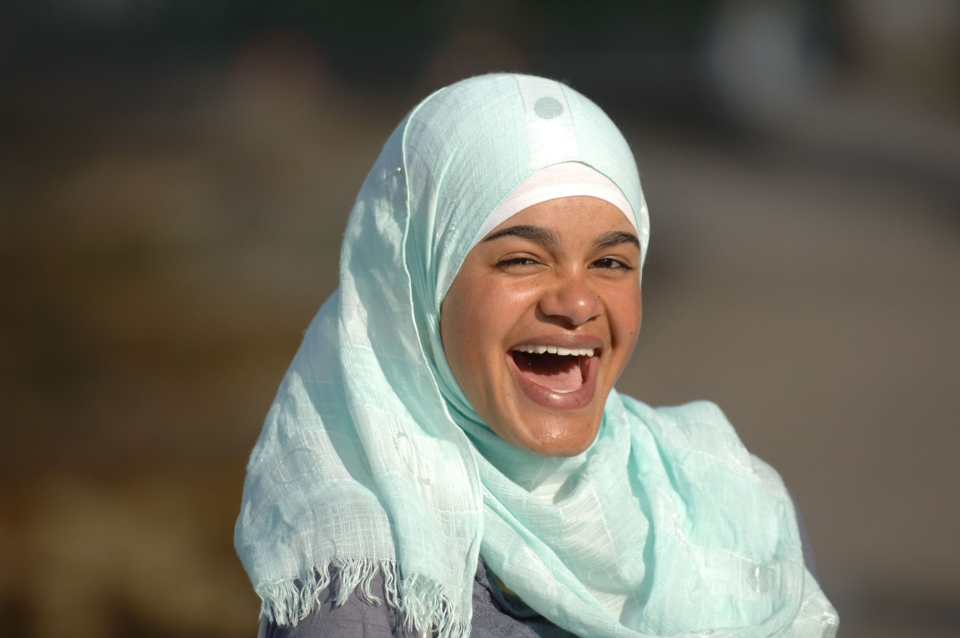

Slide 16

www.columban.org.au

Slide 17
Reasons for Dialogue - 3
Church Teaching
  Vatican II, Nostra Aetate, 1965
  Sec. Non-Christians, Dialogue and Mission, 1984
  John Paul II, Redemptoris Missio, 1990
  PCID & CEP, Dialogue and Proclamation, 1990
  PCID, Dialogue in Truth & Charity, 2014

Slide 18
CHOICE?!
A Native American grandfather was talking to his grandson about how he felt about a tragedy. He said,
  ‘I feel as if I have two wolves fighting in my heart. One wolf is the vengeful, angry, violent one. The other wolf is the loving, compassionate one.’
The grandson asked him,
‘ Which wolf will win the fight in your heart?’
The grandfather answered,
‘The one I feed.’

